Slide 1
A Look at the Early Childhood Collaborative of Southington February 26, 2025

Slide 2
Did you know?
A message from Joanne Kelleher, Director of the Early Childhood Collaborative of Southington, “I am familiar with Read to Grow's offerings, know Suzannah, and have our third annual bookmobile tour scheduled in Southington in August.

Slide 3
The Power of Community!

Slide 5
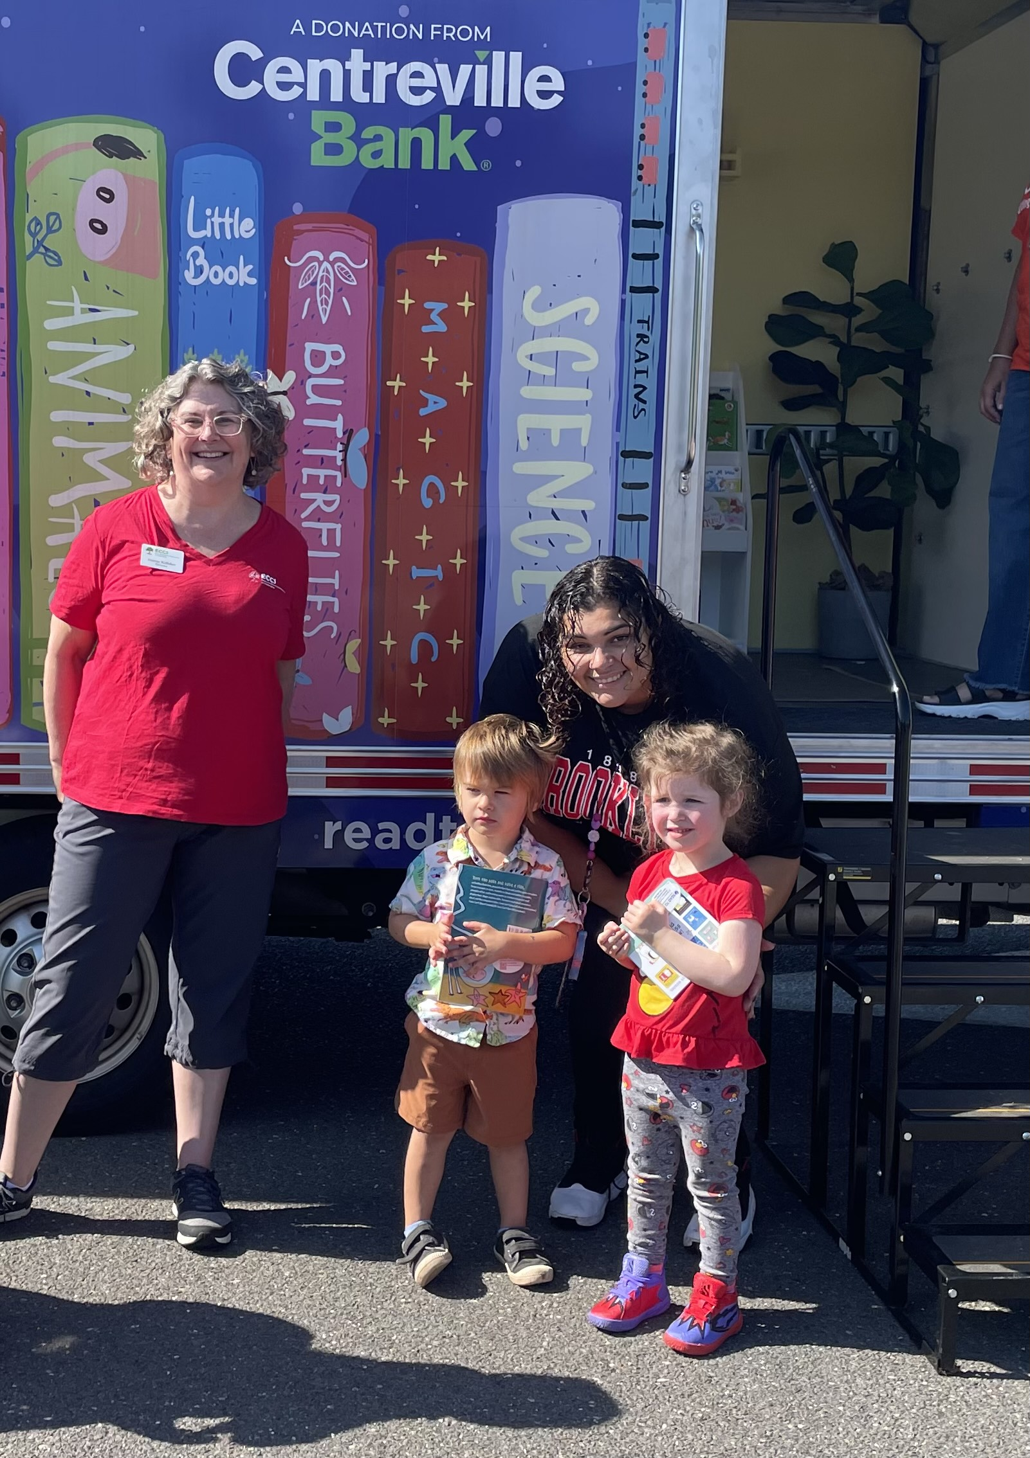
Pictures from the Event!!

Slide 8
Final Words….
“The ECCS has also ordered free books from Read to Grow for our annual holiday project.
Southington Community Services gives us a list of all of the children receiving holiday gifts through their agency. We get age-appropriate books and package them along with information about the ECCS, Sparkler and the Southington Library.
Community Services then distributes the books with their other holiday gifts.”
~Joanne Kelleher, Director Early Childhood Collaborative of Southington

