Slide 1
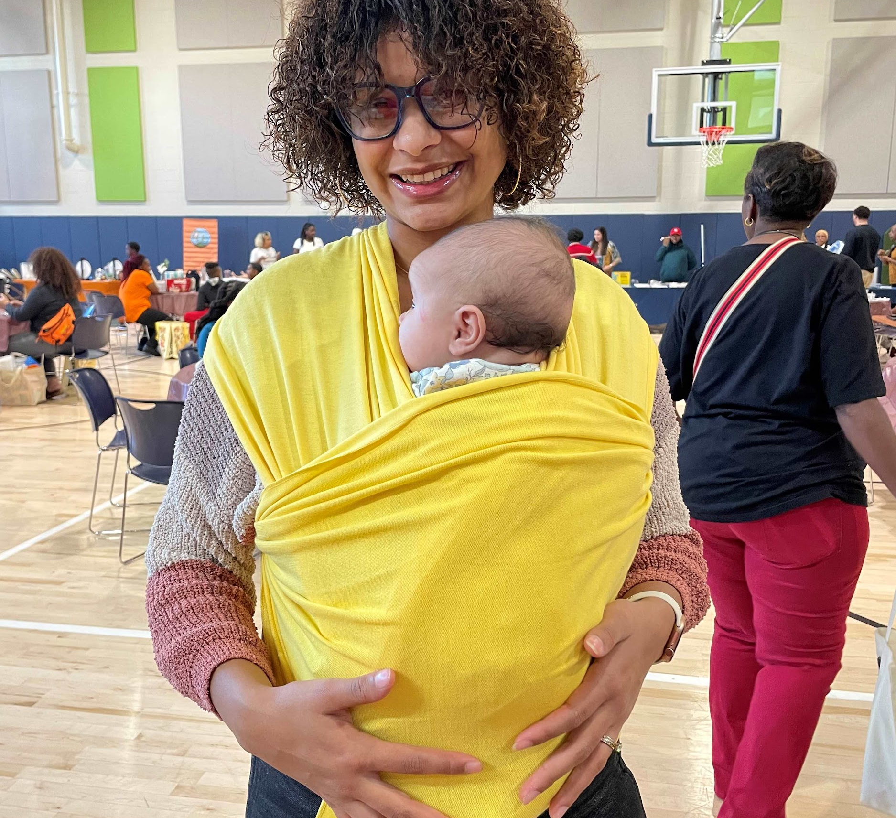
Suzannah Holsenbeck
Executive Director
sholsenbeck@readtogrow.org
Kascia Williams
Program Director
kwilliams@readtogrow.org

Slide 2
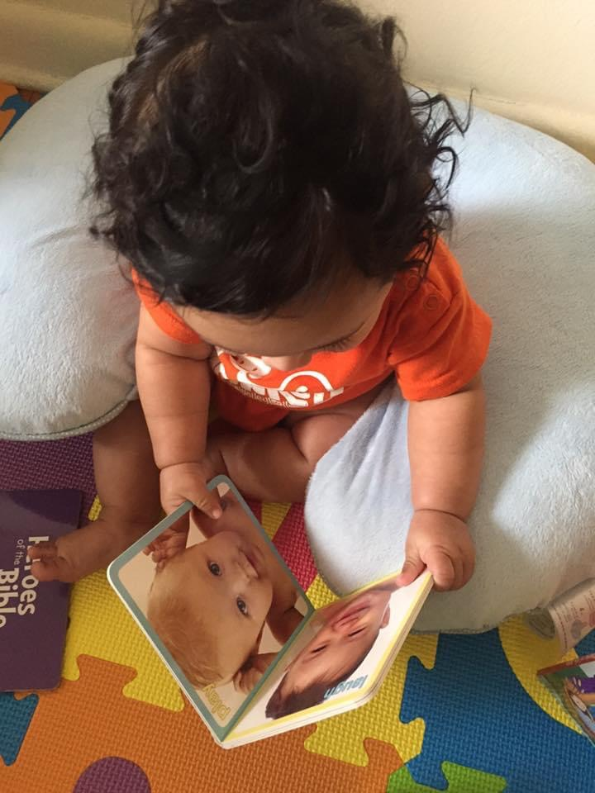
Did You Know?
Connecticut consistently ranks among the bottom five states with the largest academic achievement gaps.
Nearly 40% of households in Connecticut are either income-restricted or living below the poverty line, which significantly impacts their ability to access books.
According to the Connecticut Department of Education, only 35% of children entering kindergarten in Connecticut are on grade level for literacy when they start.
According to the 2023 CT State of Babies Report, only 48% of Connecticut families reported reading daily to their young children.

Slide 3
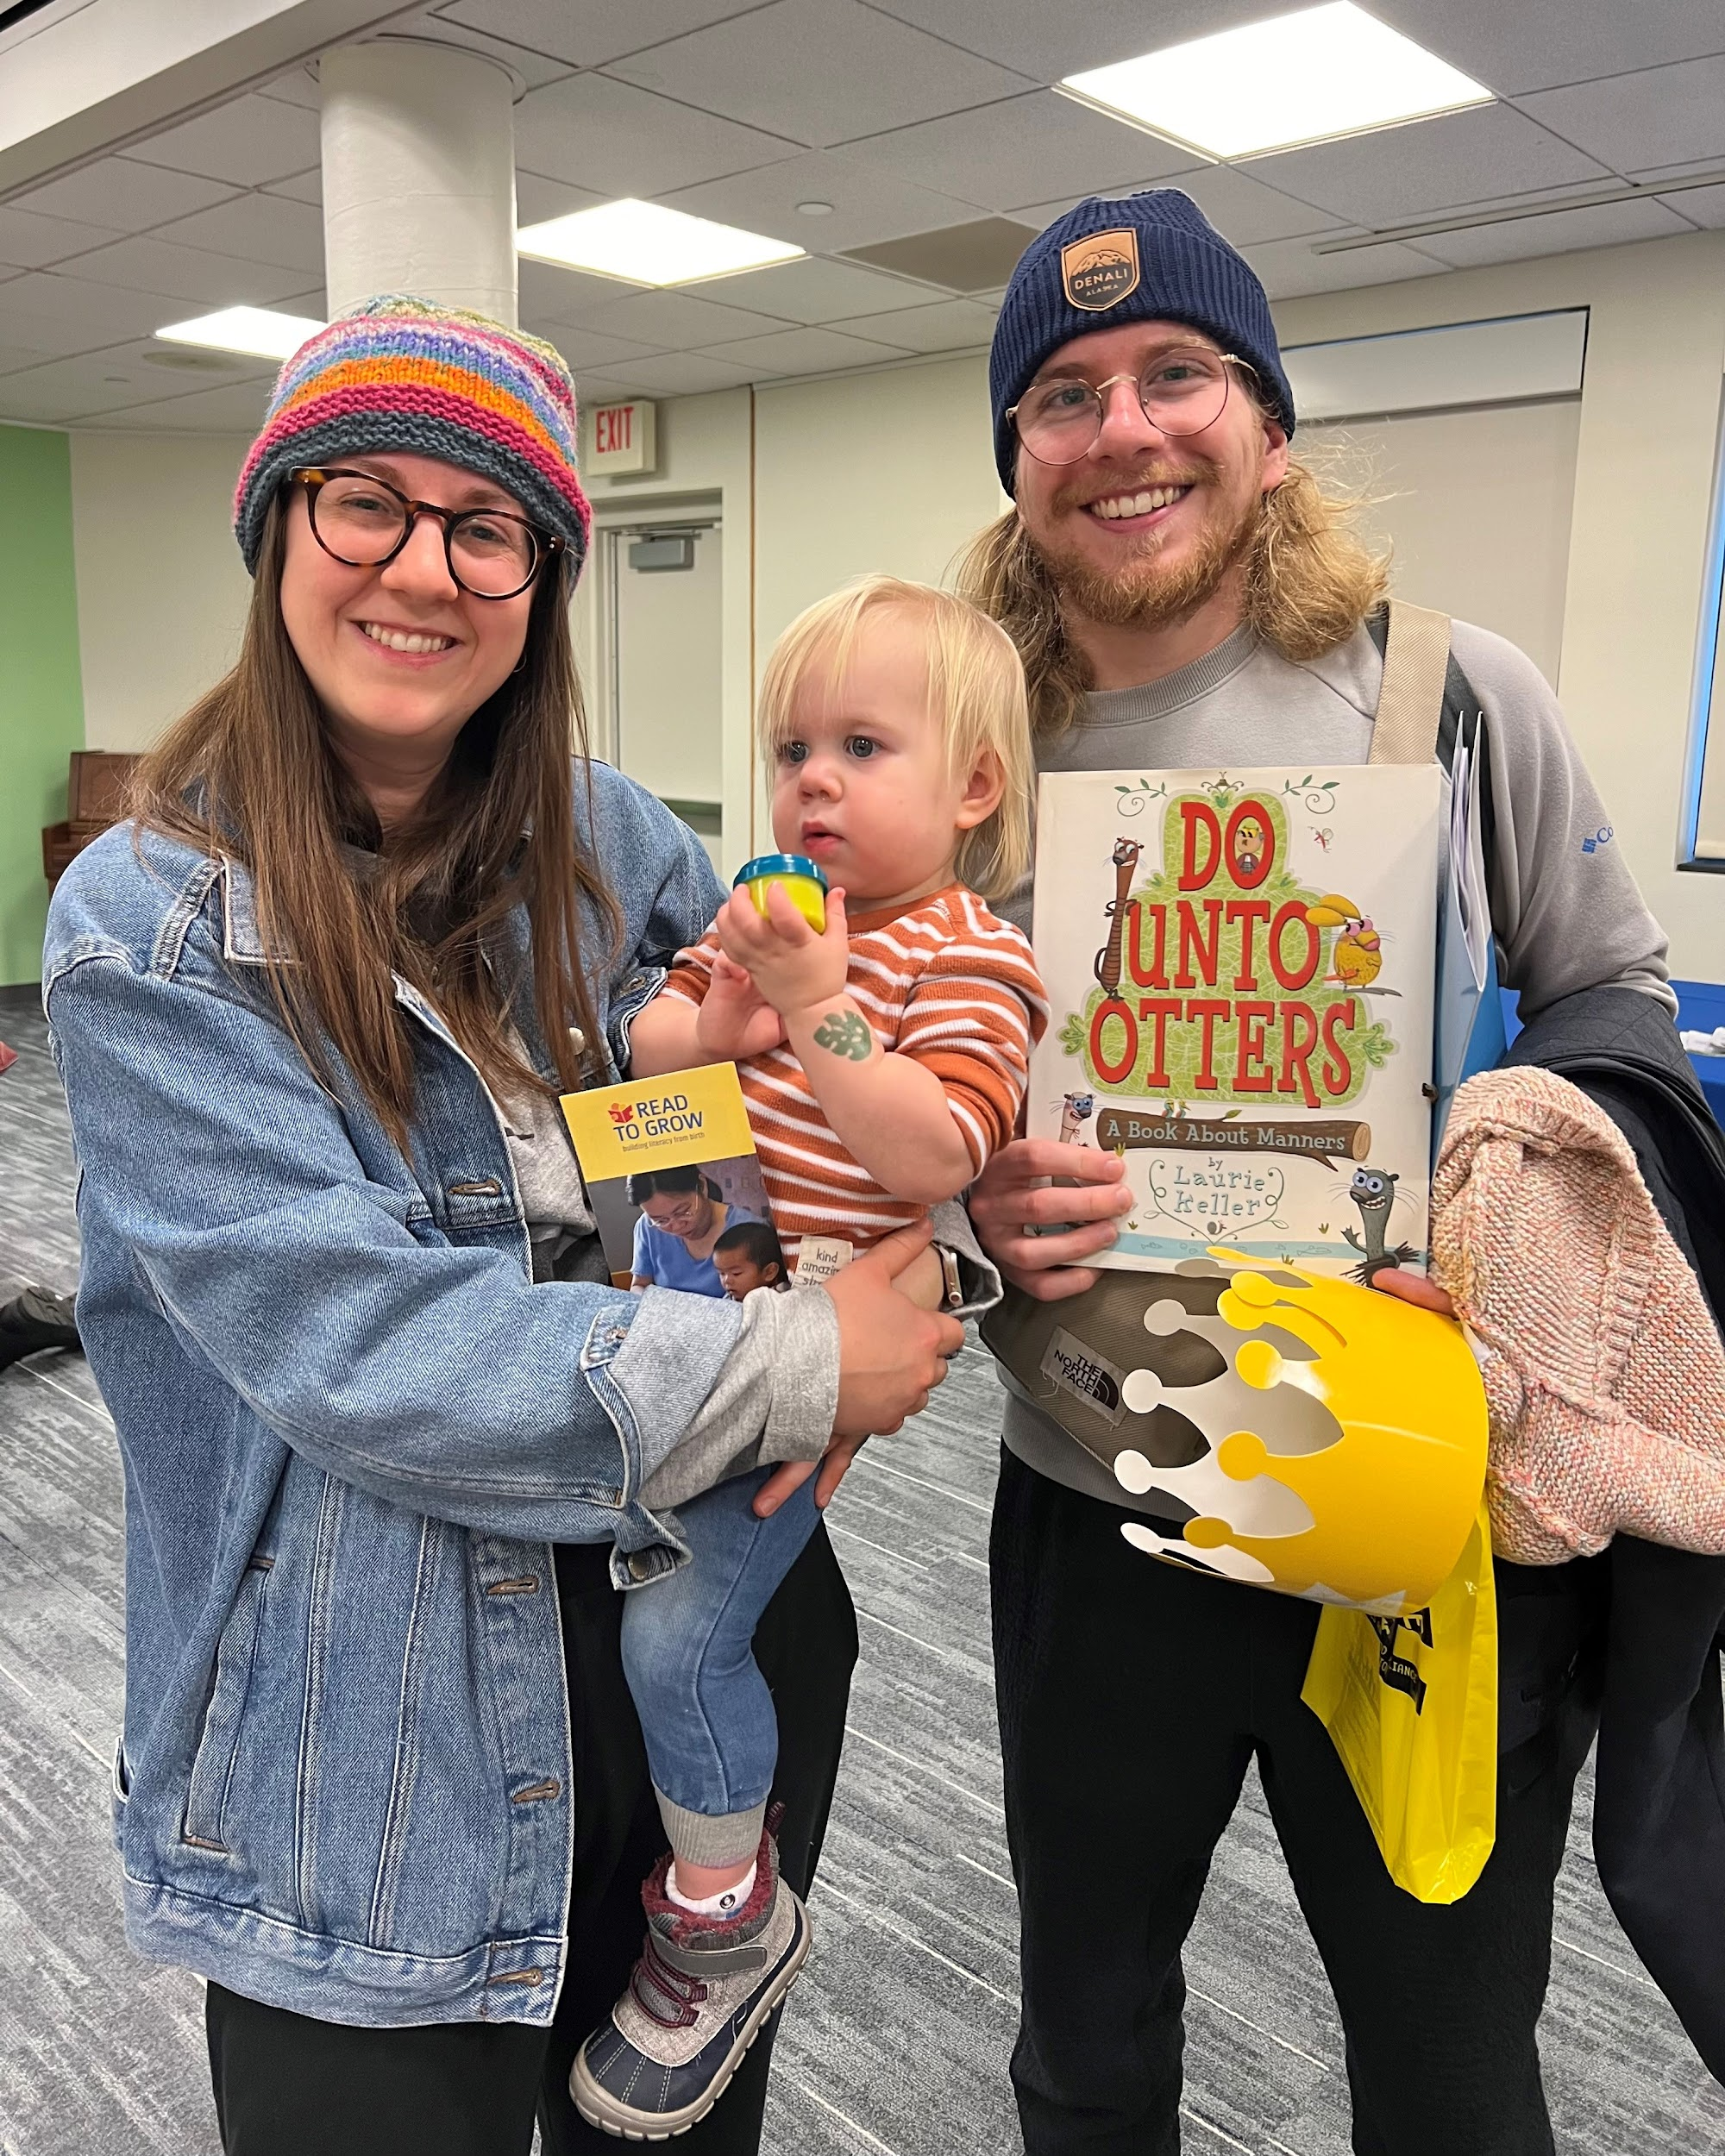
Who We Are
Read to Grow is a nonprofit organization that provides free, developmentally relevant books and literacy resources to children and families across Connecticut.
Our mission is to promote language skills and literacy skills for children, beginning at birth, and to support families as their babies’ first teachers.
We do this through our three programs: Books for Babies, Books for Kids, and Bookmobile.

Slide 4
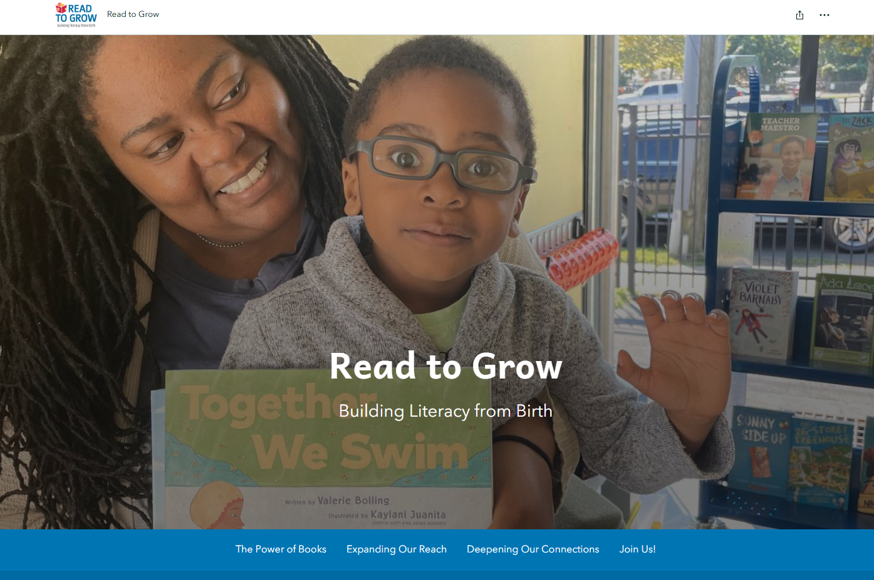

Slide 5
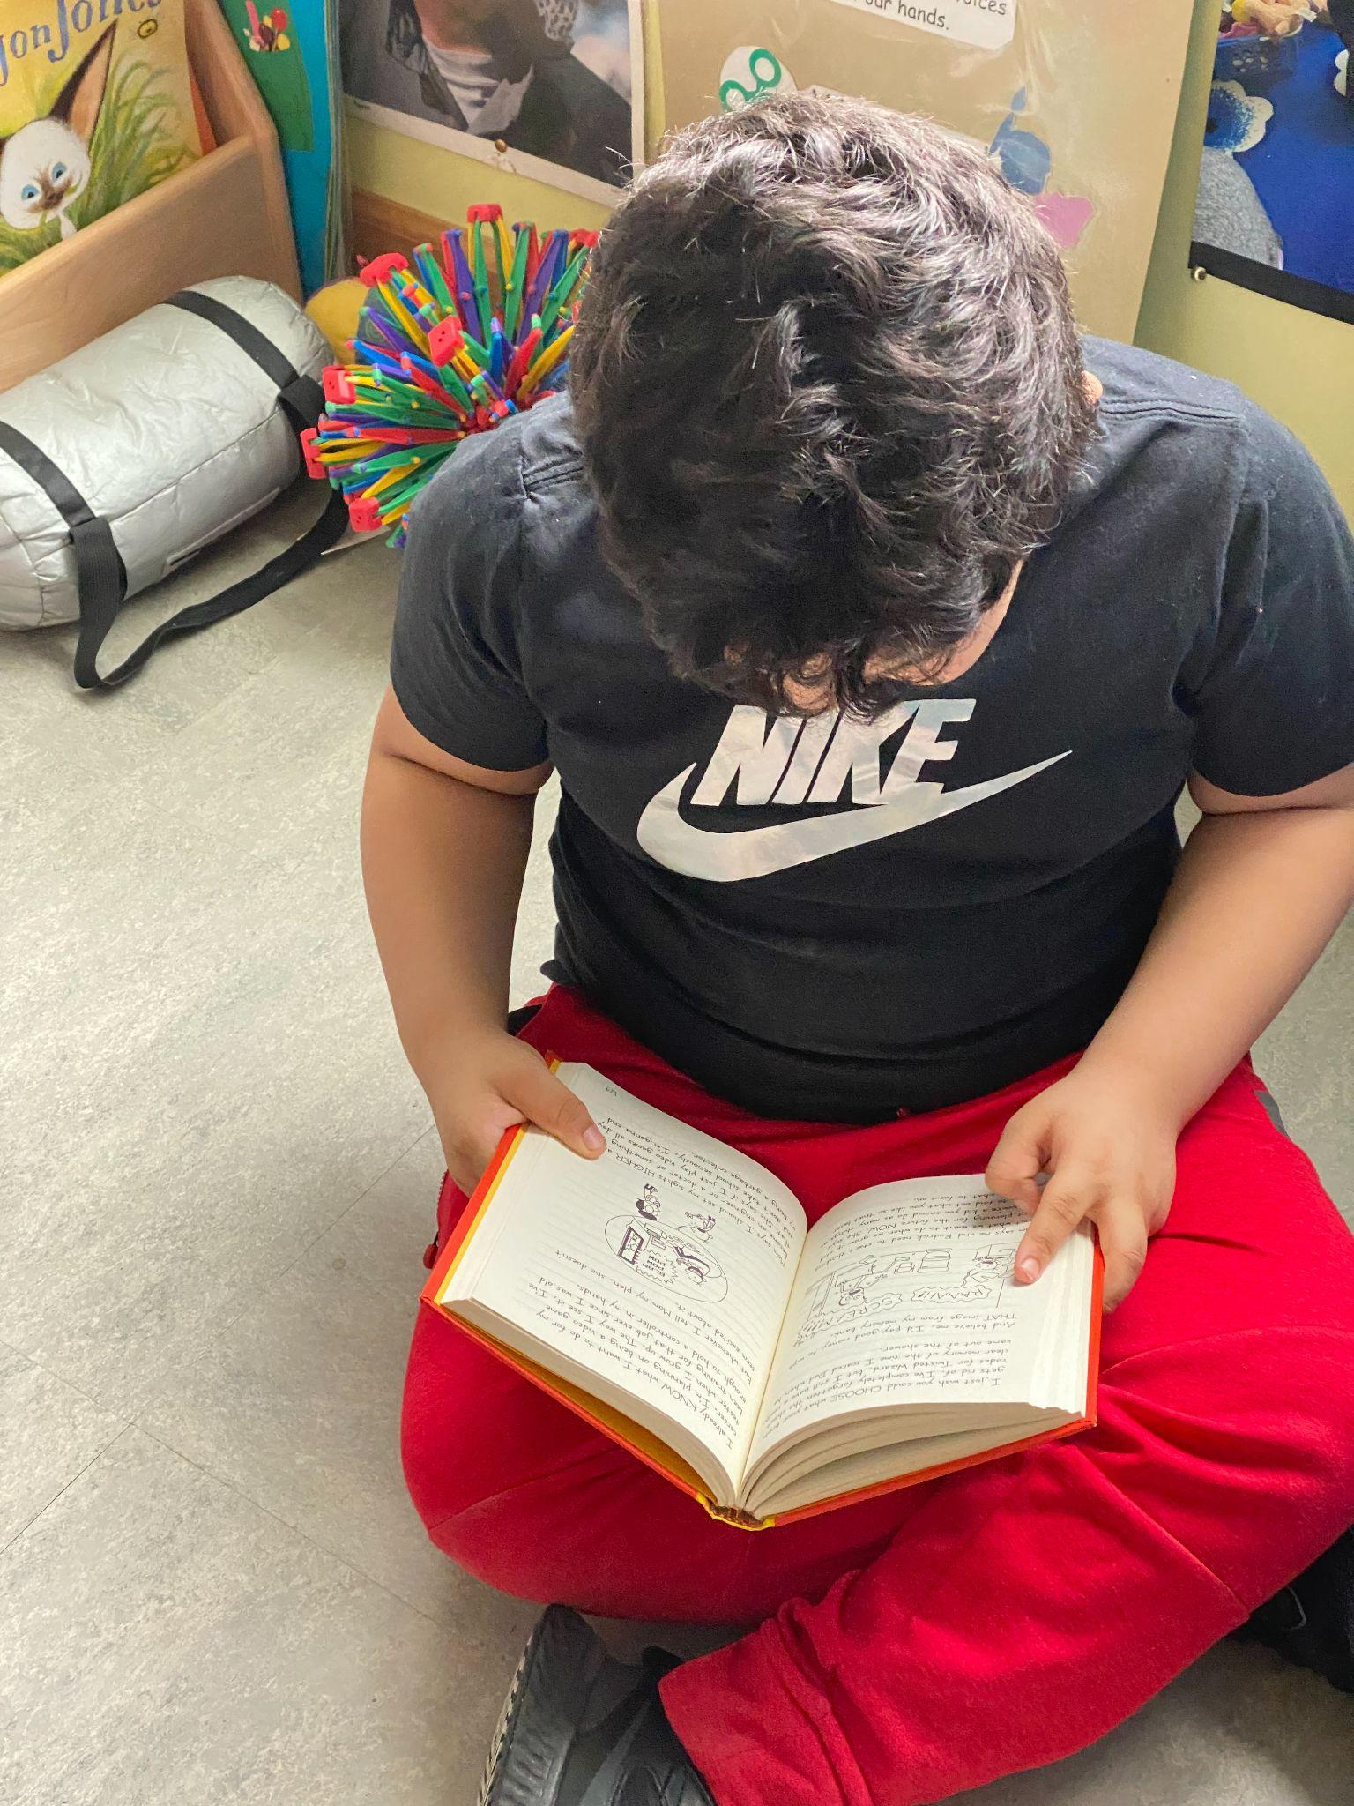
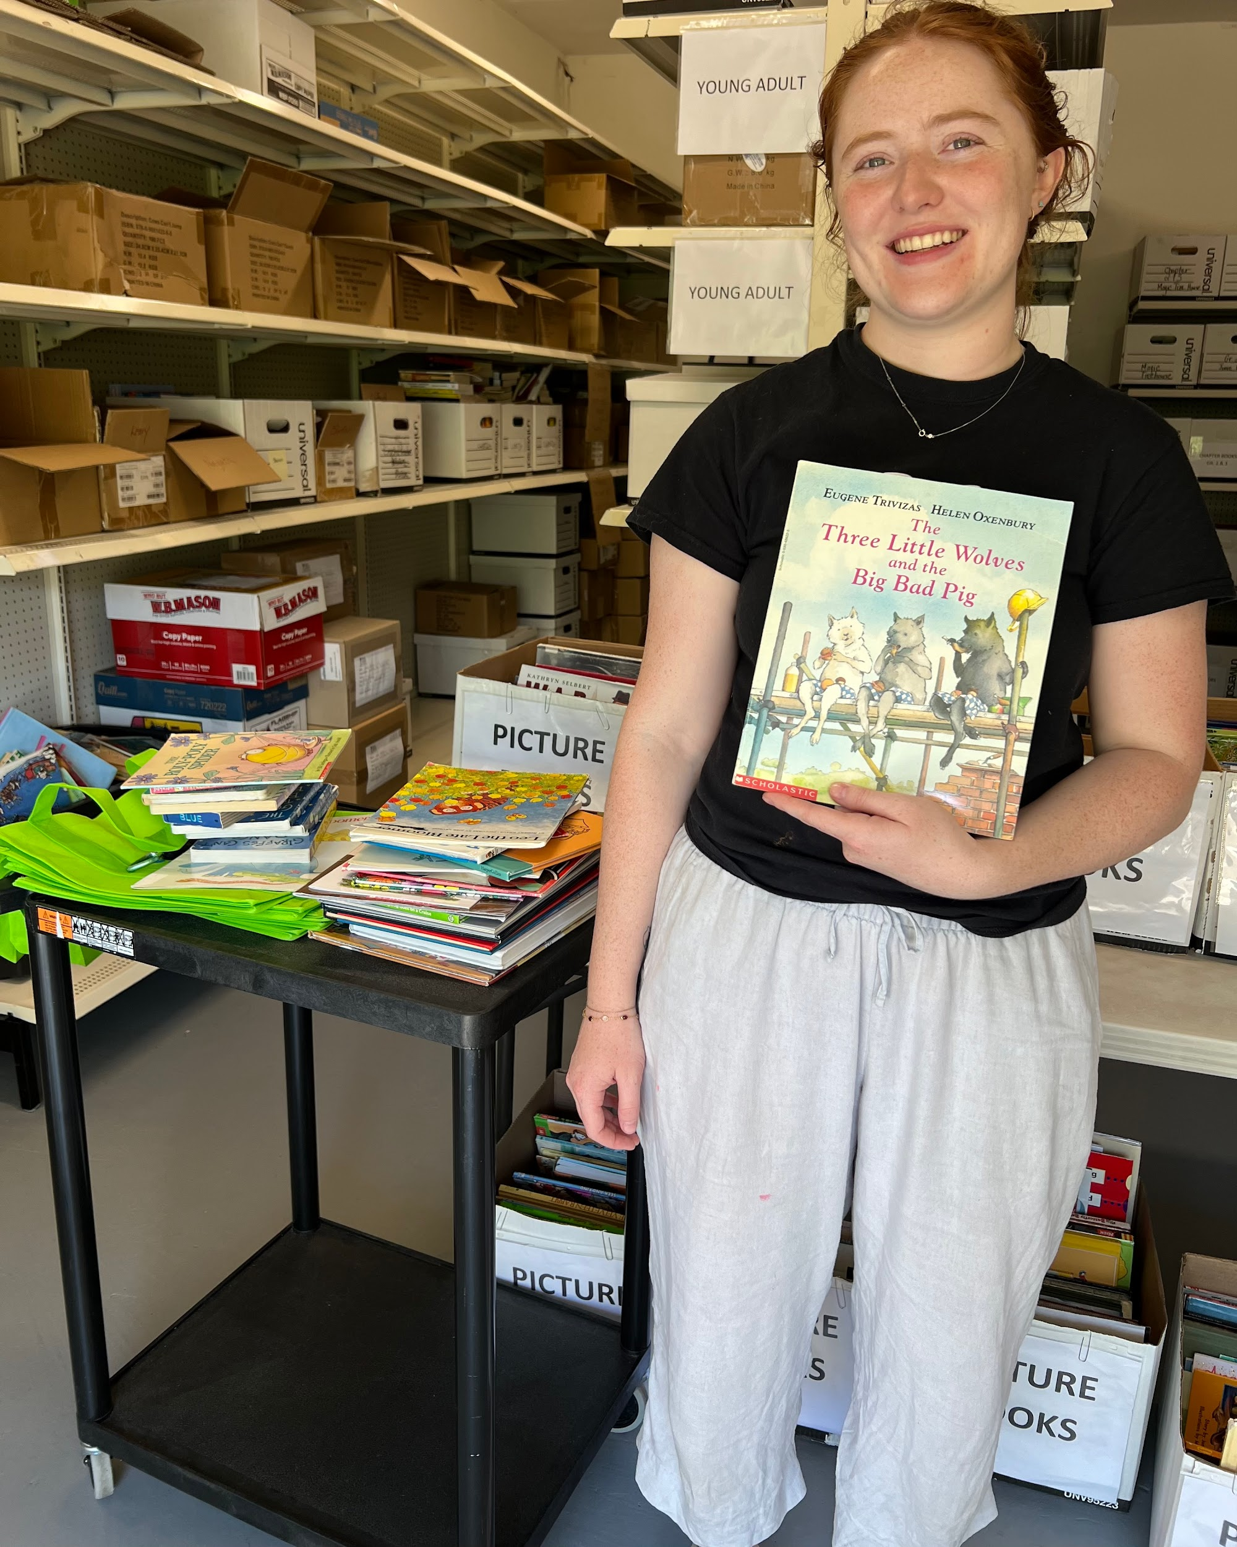
Our Books for Kids program was designed as a continuum for early childhood literacy, providing books and resources for children of all ages. The program reaches families who have benefited from our Books for Babies program as well as those who have not.
Each year, Books for Kids distributes over 80,000 books to families with children across Connecticut, both directly and in partnership with childcare providers and agencies that support these families.

Slide 6
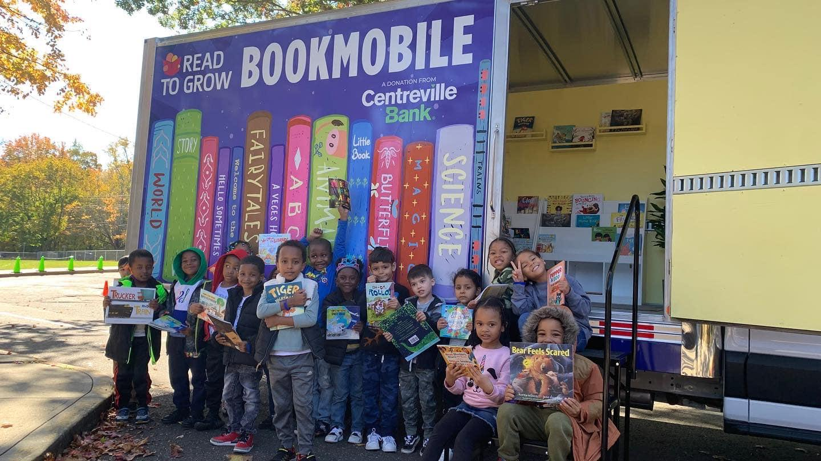
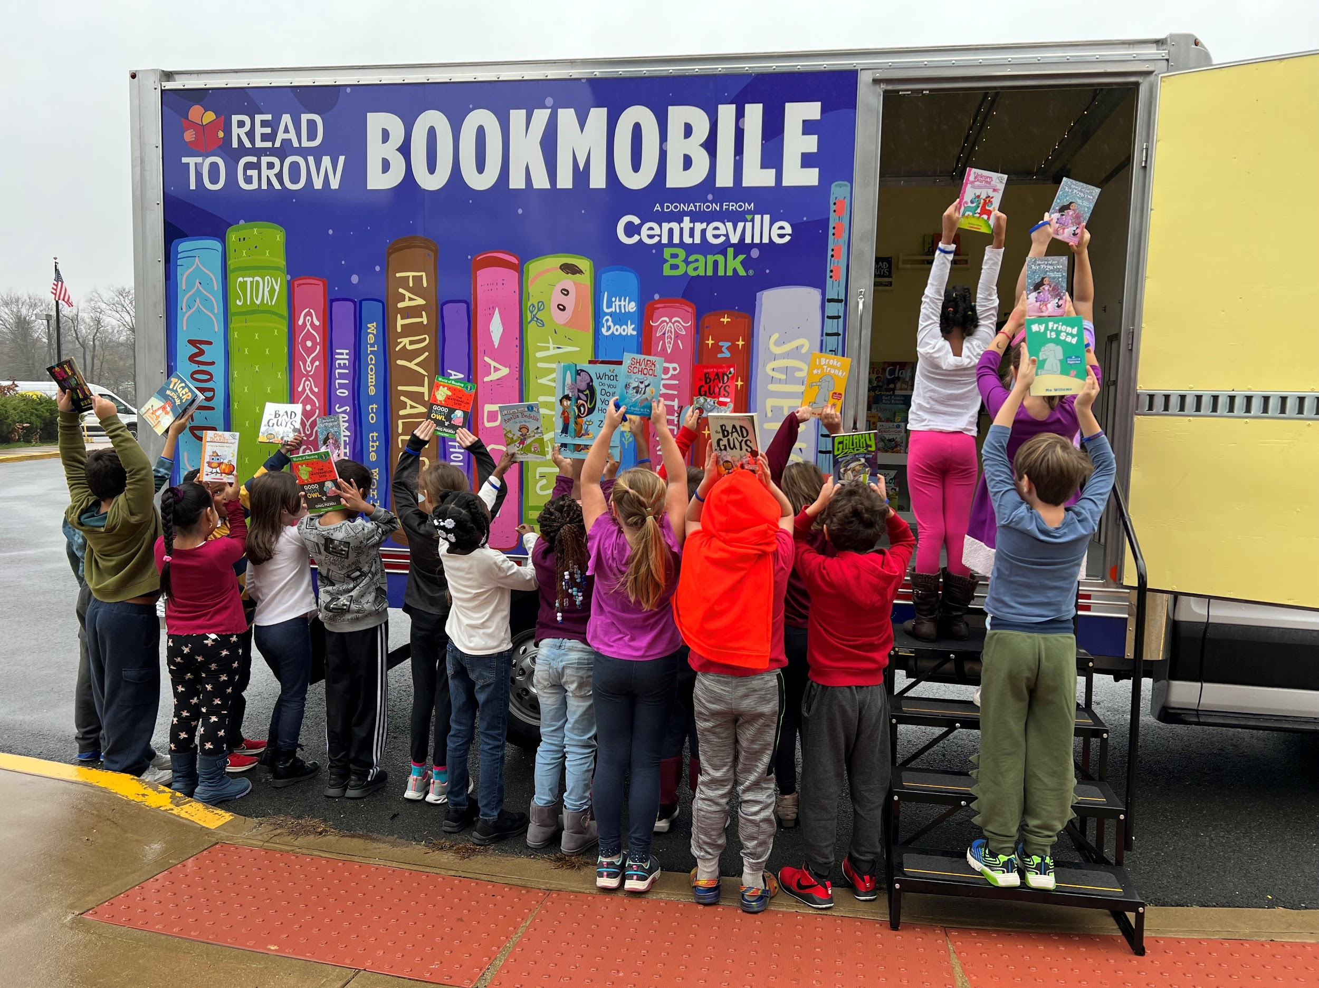
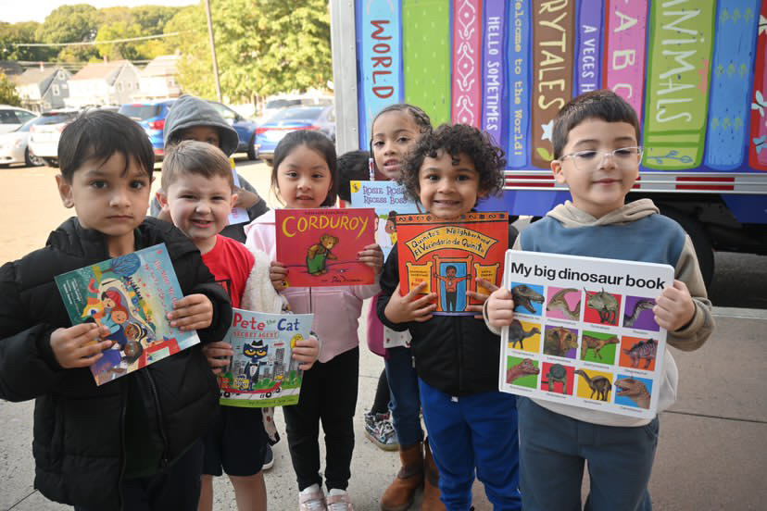
Our Bookmobile travels across Connecticut, bringing the joy of books and reading to children and families in diverse communities, with a special focus on both rural and urban areas.
Since its launch in 2023, the Bookmobile has made 230 stops and distributed nearly 24,000 books.

Slide 7
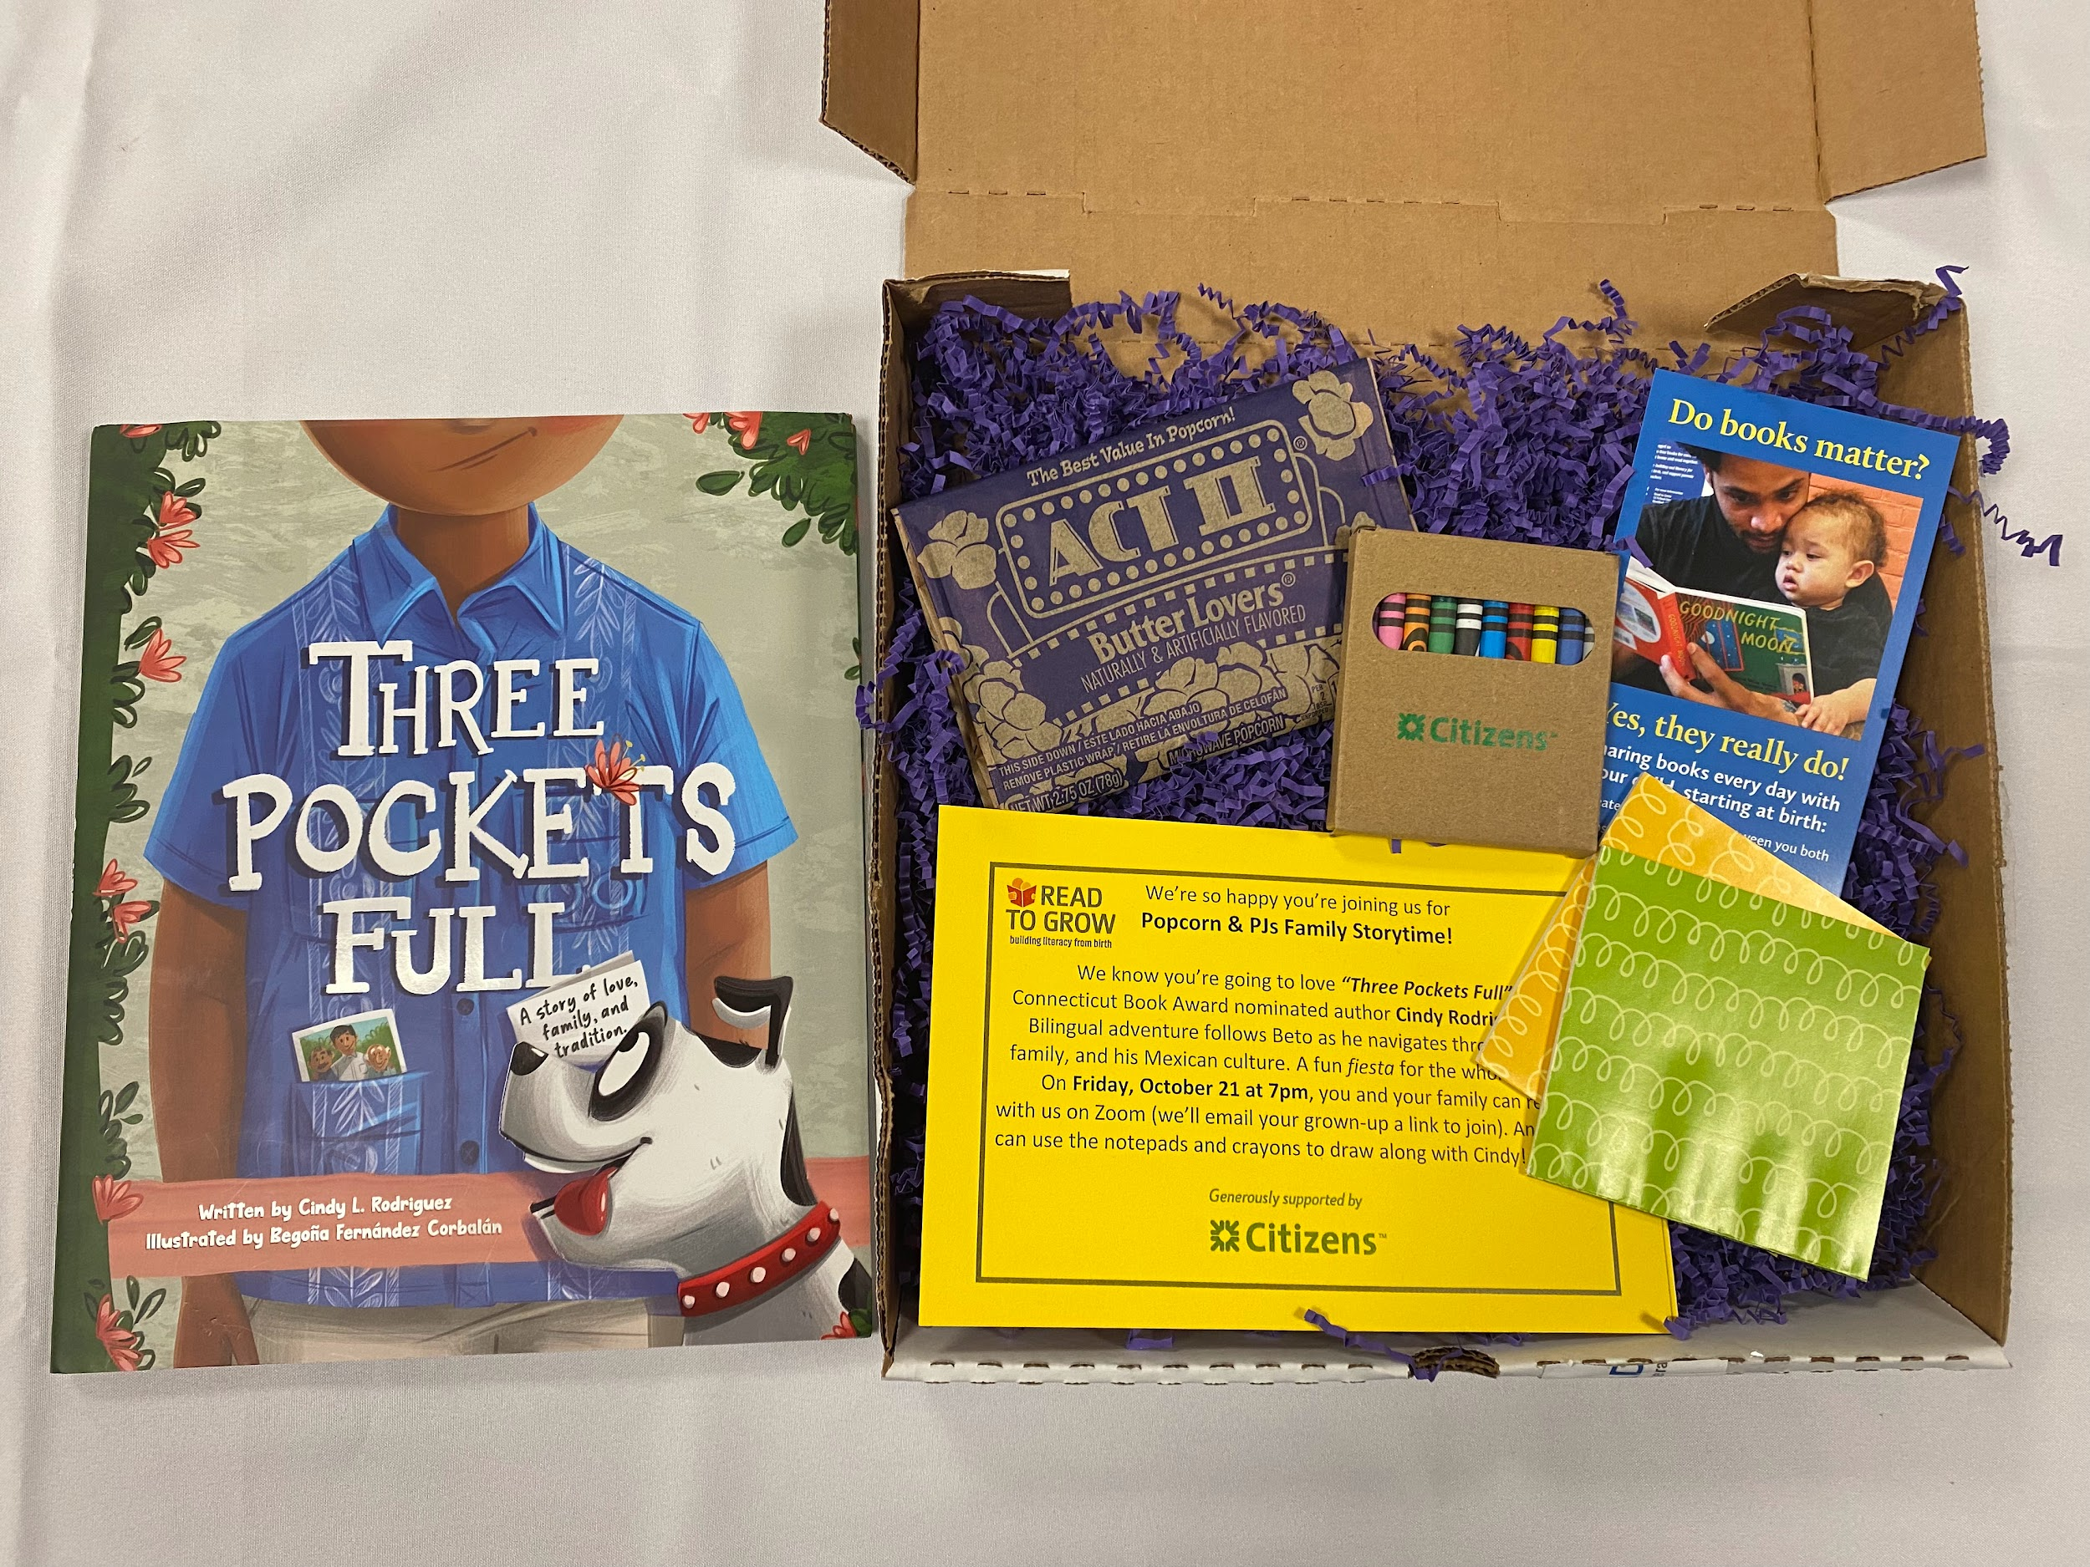
Through Popcorn & PJs: Virtual Family Storytime, Read to Grow brings families together for a fun-filled virtual experience with the author of a featured story. The author will read the book aloud, bringing the characters and storyline to life. After the reading, they will answer questions from the audience, share insights about the story, and lead a literacy-based activity to engage both children and parents.
Popcorn & PJs is the perfect way to inspire a love of reading and learning in a relaxed, family-friendly setting.

Slide 8
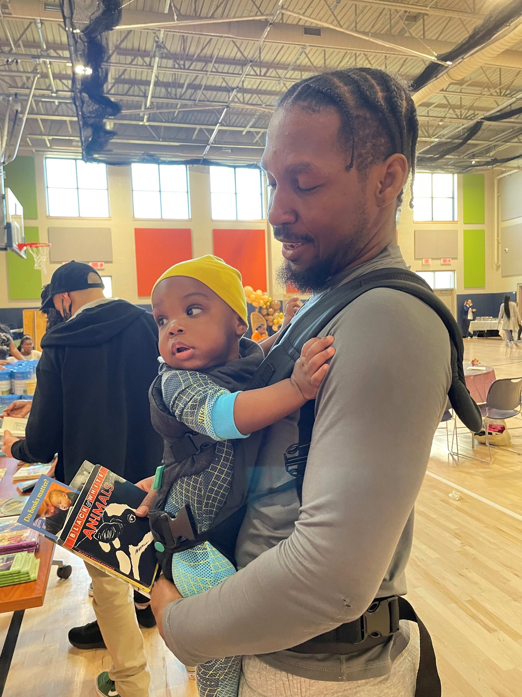
How to Access our Resources?
Make a book request with Books for Kids!
Request for a family? Click here
Request for an organization? Click here
Request our Bookmobile!
Interested in having our Bookmobile at your community event, school, or child care center? Click here
Join us for Popcorn and PJs!
Interested in our virtual storytime, led by a featured author? Click here for more information

Slide 9
Thank You

