Slide 1
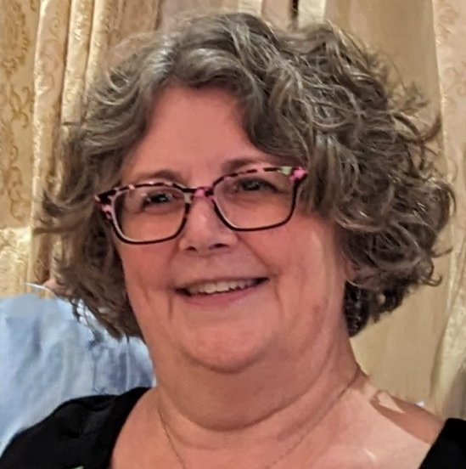
Joanne Kelleher Joanne Kelleher is the Executive Director of the Early Childhood Collaborative of Southington She can be reached at: southingtonearlychildhood@gmail.com

Slide 2
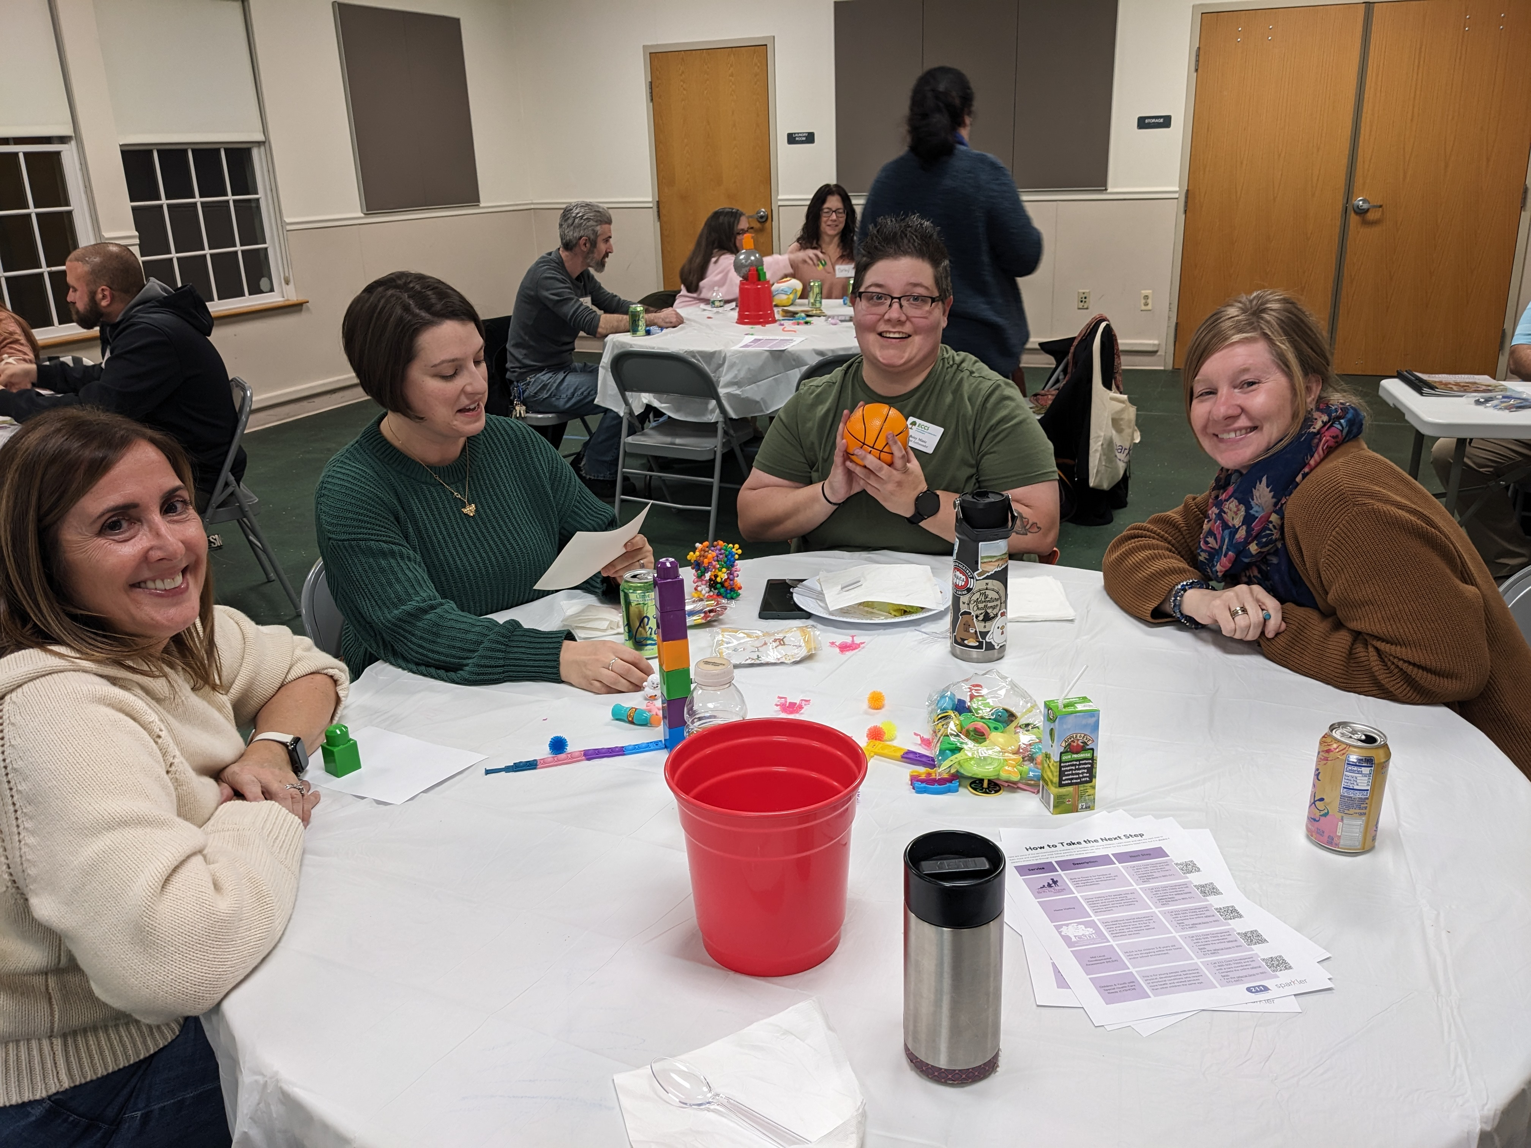
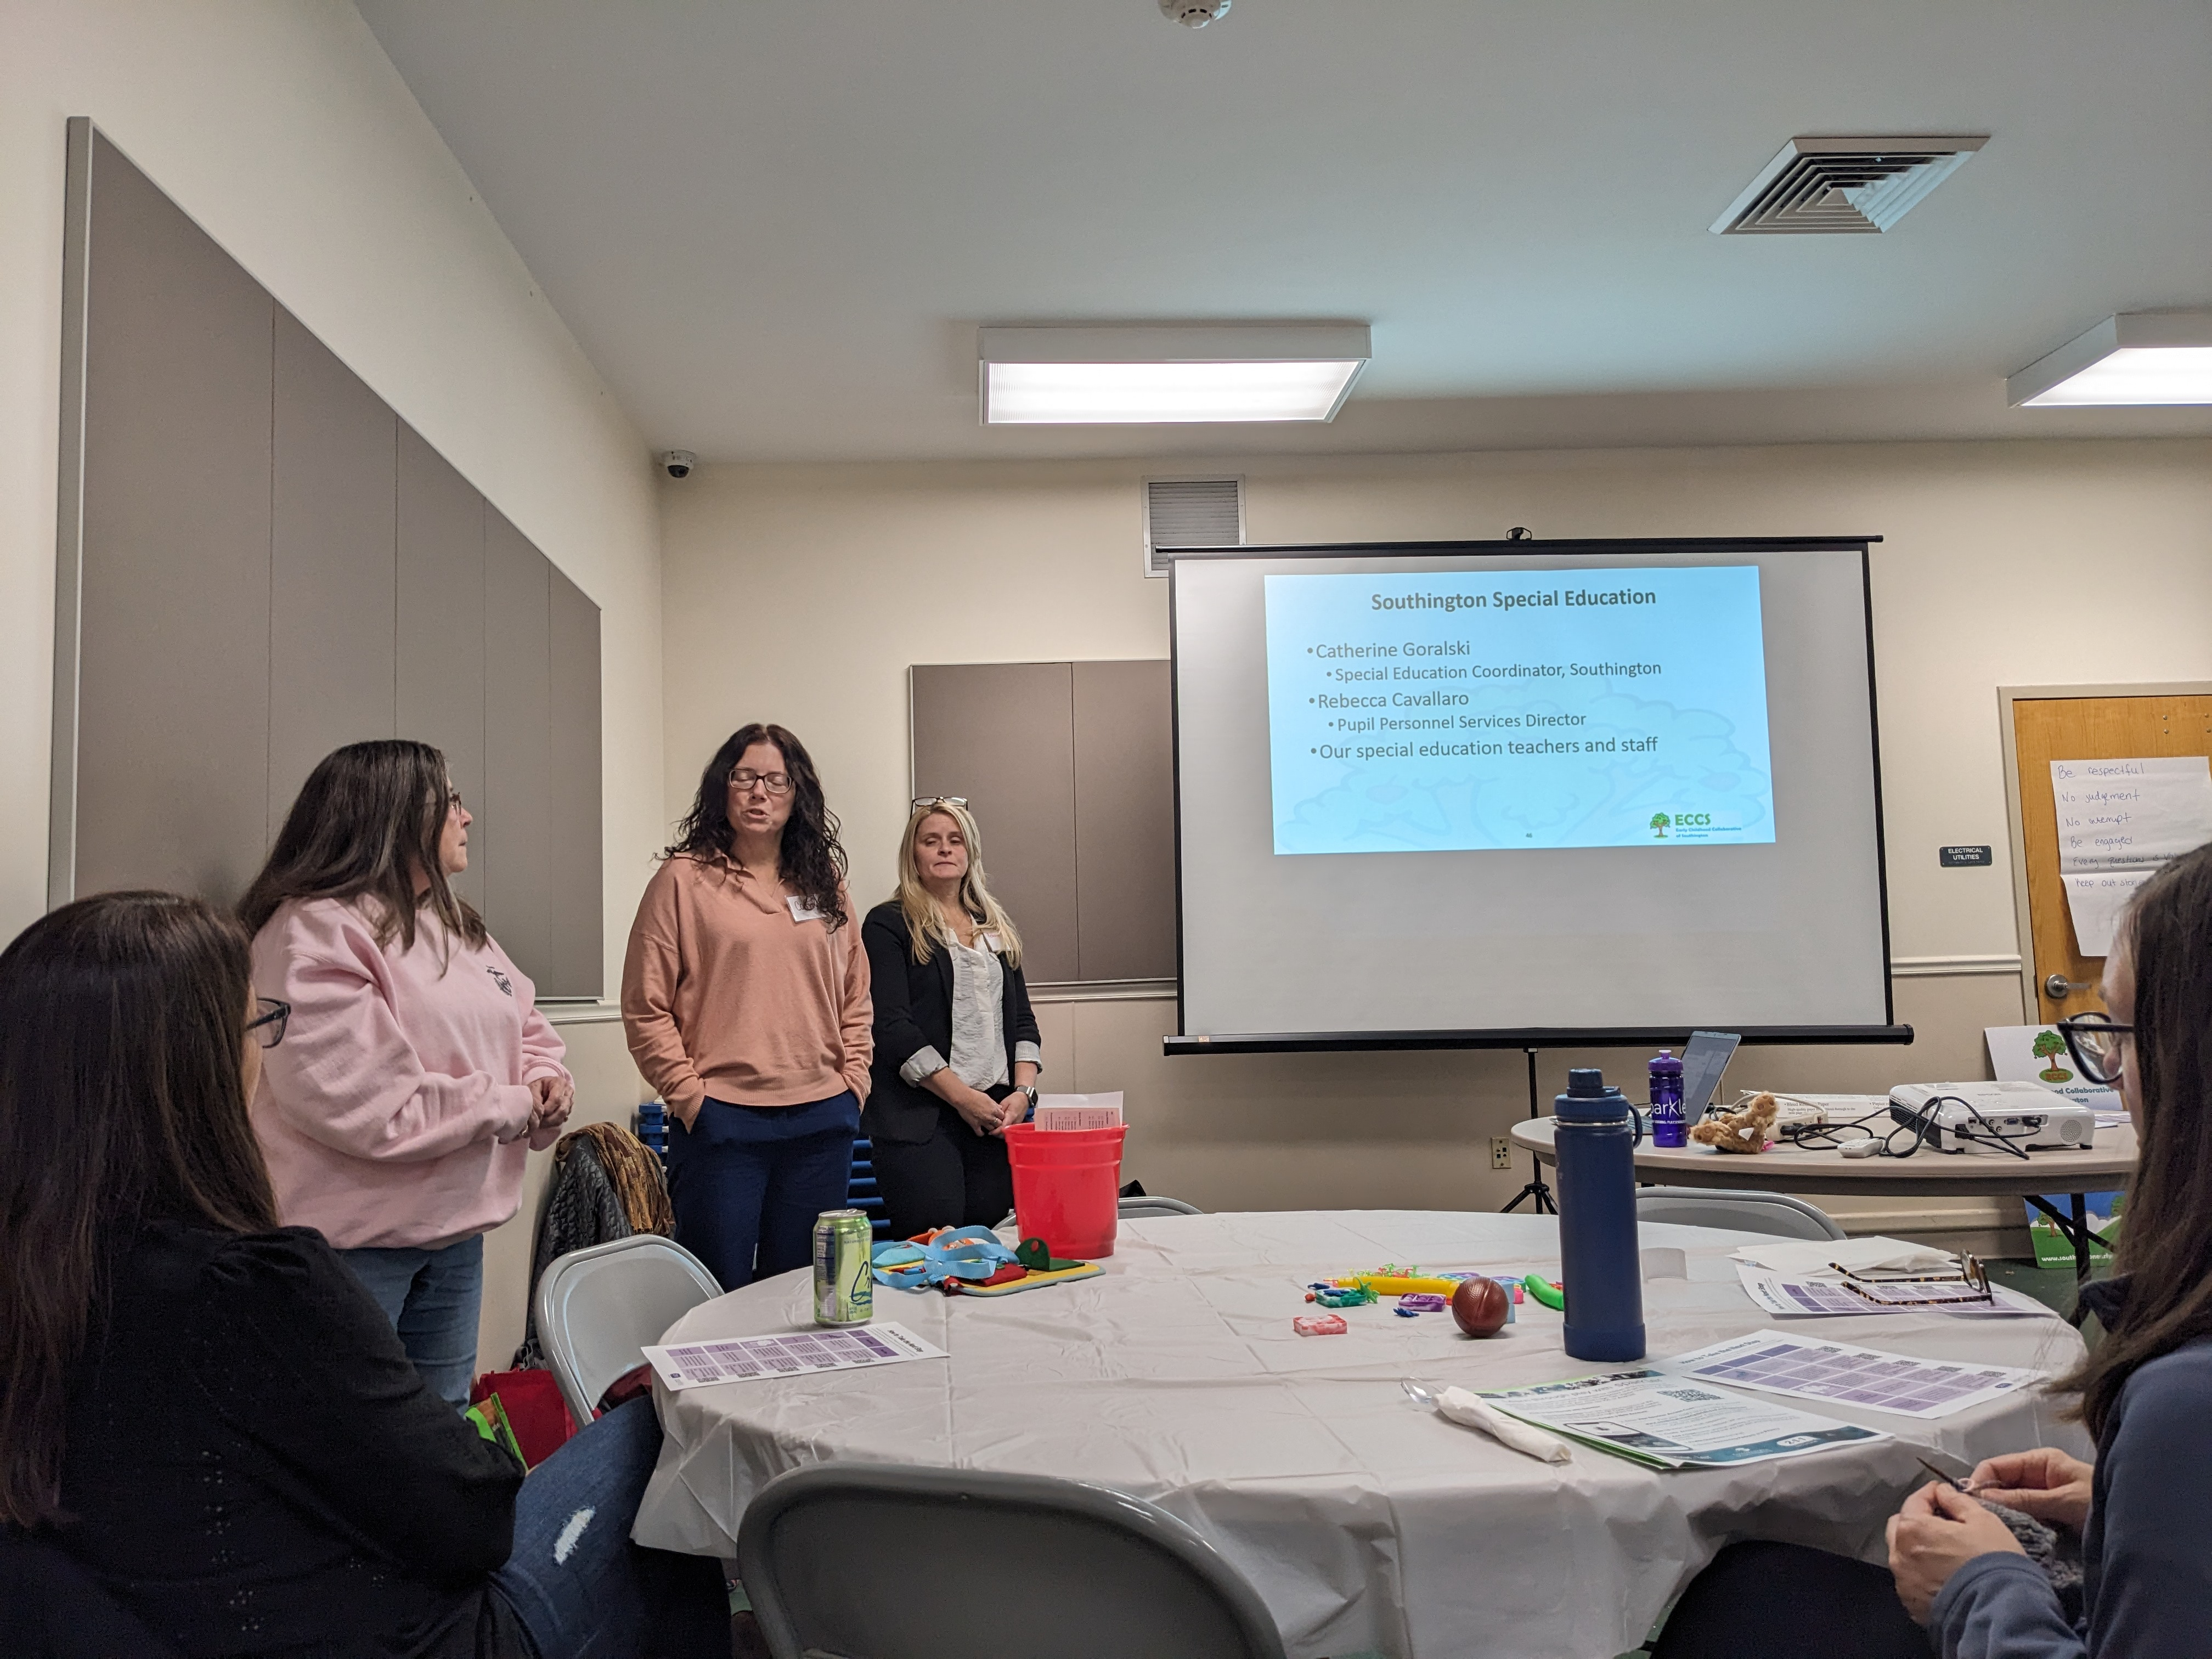
On November 2023, Parent Ambassadors organized a Community Café where it was discussed how to identify and support Southington’s young children with disabilities or developmental concerns; there was also discussion around forming a SEPTA.

Slide 3
Link to Community Cafe - Developmental Concerns - ECCS (southingtonearlychildhood.org).

