Slide 1
Fatherhood Engagement
Services
FES Supervisor - Don Crocker
May 17, 2023
Notes:
Context informing today’s content

Slide 2
Community Partner
Father Engagement Services (FES) is a grant-funded program through the Department of Children and Families (DCF). Currently, The Village for Families & Children is the only FES in DCF Region 4. The Village provides direct care services to DCF involved fathers referred to FES.
Notes:
Context informing today’s content

Slide 3
FES IS A FATHER DRIVEN PROGRAM
Intensive Outreach
Fathers are met where they are (home, barbershops, bowling alley, bodega, work, school, stores, etc.)
Case Management Services
Helps to mitigate barriers for more effective engagement through assessment of needs, advocacy, and linkage to supports and services

Slide 4
FES IS A FATHER DRIVEN PROGRAM
24/7 Dad© Program
Teaches skills and characteristics to strengthen the father’s parenting relationship

Slide 5
ENGAGED FATHERS
Research suggests that children with involved and engaged fathers tend to have more positive outcomes relative to physical, cognitive, and social emotional health.

Slide 6
WRAP AROUND
Using components of the WRAP AROUND approach; FES works with fathers in creating a care plan focused on the family’s strengths and needs.

Slide 7
FES STAFF
The FES Team assists fathers in meeting needs by:
Establishing links to community supports, including, but not limited to services for food, clothing, shelter, mental health and/ or substance abuse treatment
Working with families to identify and mobilize natural supports
Providing information on parenting and child development or other interventions
Increasing safety for children
Supporting fathers’ connections with their child’s school community
Notes:
Context informing today’s content

Slide 8
FATHER ENGAGEMENT SERVICES PHILOSOPHY
“The Village’s FES Program works with fathers from a strength-based, family-centered, and culturally informed approach. The model includes components of empowerment, resiliency, parent education, and support. Understanding each father’s history and direction is distinctive; the measurement of how each element is measured is enclosed. The individual strengths, needs and make up of each father will drive the approach of services.”
.
Notes:
Context informing today’s content

Slide 9
REFERRAL PROCESS
DCF Gatekeeper will send the referral to the Program Supervisor. Upon receipt, the Program Supervisor will confirm receipt via email to the DCF Gatekeeper.
The Program Supervisor will assign the referral to a Fatherhood Engagement Specialist.
The FES Specialist will contact the Social Worker within 48 hours of the assignment of the new case and document in Apricot.
The FES Specialist will reach out to schedule an intake with the client. The first method of initial contact will be by phone.
The intake will be scheduled within 5 business days of the assignment with multiple contact attempts being made immediately upon assignment. Documentation of all attempts will be made in Apricot.
Notes:
Context informing today’s content

Slide 10
DCF FORM 2265
Date of referral, area office, Family LINK number, DCF Worker and Supervisor contact information, information on individuals living in the home (name, relationship including child’s gender, date of birth, and individual LINK numbers) address, phone numbers, information on non-custodial parents, fathers preferred language, presenting issues/concerns, relevant history (risk factors that may impact worker’s safety and prior involvement with DCF), and strengths. Authorization for the release of information form signed by the father (gives permission for DCF staff to communicate with FES) with appropriate agency name, signature, and date of signature
.
Notes:
Context informing today’s content

Slide 11
FATHER’S CREED
.
Notes:
Context informing today’s content

Slide 12
BARRIERS
Child Welfare Agencies (like DCF) struggle to engage fathers and paternal relatives.
Fathers fear involvement with the child welfare system.
Agencies are less likely to make concerted efforts to involve fathers than mothers (52% vs. 67%).
Mothers are more likely than fathers to receive encouragement to participate in their children’s school activities, medical appointments, and after-school programs (45% vs. 19%).
A lack of standards and guidelines for engaging fathers and paternal relatives can challenge agency staff.
Potential beliefs by staff about lack of interest by fathers regarding active involvement with their children.
Staff may be more comfortable working with mother.
Notes:
Context informing today’s content

Slide 13
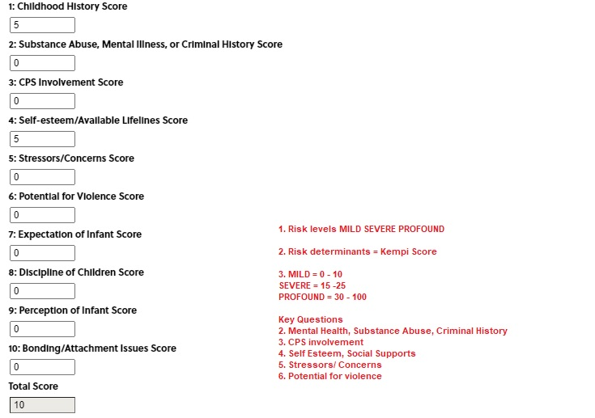
KEMPE ASSESSMENT
.
Notes:
Context informing today’s content

Slide 14
QUESTIONS?

