Slide 1
FAVOR
PROGRAM
ORIENTATION
Presentation - 2024

Slide 2
ABOUT US
FAVOR, Inc. (FAVOR) is a statewide, family-led, non-profit -organization that is committed to empowering families and partners in improving educational and health outcomes for our children.
FAVOR is a Connecticut state affiliate organization of the Federation of Families for Children’s Mental Health.
OUR PURPOSE
FAVOR offers a single place for families with children who have mental, behavioral and special health care challenges to find information, assistance and training.
Our philosophy exemplifies our key core values: family empowerment, mutual respect, accountability, and partnership.

Slide 3
PROGRAMS
FAMILY PEER SUPPORT SPECIALISTS (FPSS)
FAMILY SYSTEMS MANAGERS (FSM)
CONNECTICUT MEDICAL HOME INITIATIVE (CT-MHI)
LEARNING AND LEADERSHIP ACADEMY
Create integrated networks of care that champions the family and youth voice.
Provides virtual and in-person trainings and community conversations.
Provides direct services to families in need.
Assists families to obtain medical equipment, prescriptions, and respite for caregivers of children with special healthcare needs.

Slide 4
WHO WE SERVE
FAMILIES & CAREGIVERS
YOUTH/YOUNG ADULTS
We advocate for family-driven policies and practices that ensure that families have the primary role in decision-making in the care of their children whether in the home, in care, or in custody.
We respect the youth voice and strive to make sure that young adults are equal partners in creating change at the individual, state, and national levels.
PROVIDERS
We partner with service providers who work with our families to promote family engagement and family voice.

Slide 5
FAMILY PEER SUPPORT SPECIALISTS (FPSS)
The Family Peer Support Program provides direct peer support services to families with children who have mental, behavioral health and/or special health care needs.
Our Family Peer Support Specialists assist families who need to navigate the special education, mental and behavioral health care service systems.
CAROLYN
LYNETTE
Program Director, FPSS
Triage Coordinator

Slide 6
FAMILY PEER SUPPORT SPECIALISTS (FPSS)
Services can include:
education for the parent or caregiver on your child's rights and responsibilities
attending meetings – e.g., planning and placement team (PPT) meetings – with families
working collaboratively with parents/caregivers, youths, schools, and other service providers
Family Peer Support Specialists empower families by helping them participate fully in the development and management of their child’s network of care so that they can better advocate for their child’s needs.

Slide 7
REFERRALS
SYSTEM OF CARE
BRIEF INTERVENTIONS
These referrals come from Care Coordination. Family Peer Support Specialists and Care Coordinators work as a team to assist families for a period of approximately 6 months.
These are referrals received from a variety of sources, including the family themselves, hospitals, schools, and other community providers for a period of 3 months.

Slide 8
FAMILY SYSTEMS MANAGERS (FSM)
Family Systems Managers build coalitions, connecting multiple sectors of the community to drive collaboration and to develop plans and policies to implement strategies that support prevention efforts.
FSMs collaborate with the Department of Children and Families (DCF) System Managers to analyze system needs, monitor system functioning, in order to promote and sustain system improvements across each DCF region of Connecticut.
FSMs facilitate dialogue and conduct Community Conversations to increase awareness of implicit bias in order to facilitate the promotion of an appropriate cultural response within the system.

Slide 9
FAMILY SYSTEMS MANAGERS
SYSTEM OF CARE (SOC)
COMMUNITY COLLABORATIVES
COMMUNITY CONVERSATIONS
NETWORK OF CARE
Collaboration
brings community partners together to share experiences, problem-solve, and develop innovative approaches to family engagement to further promote a full representation and equal participation of families with varied backgrounds and experiences. (e.g., ethnicity and diverse lifestyles).
LOCAL INTERAGENCY IMPLEMENTATION SERVICE TEAM (LIST)
DCF REGIONAL ADVISORY COUNCIL (RAC)

Slide 10
FAMILY SYSTEM MANAGERS
BY REGION
PAUL
KAREN
DREAU
Director of Family Engagement Programming
Patricia
LISA
KRISTIN
KEISHA

Slide 11
CONNECTICUT MEDICAL HOME INITIATIVE (CT-MHI)
In Medical Home a pediatric healthcare provider works in partnership with children and youth and their families to ensure that all the medical and non-medical needs of the children and youth are met.
Through this partnership, the provider can help children or youth and their families to access and coordinate special care, educational services, out-of-home care, family support, and other public and private community services that are important to the overall health of the child/youth and family.
IRIS
LICETTE
Program Director, CT-MHI
Asst. Program Coordinator,
CT-MHI

Slide 12
THE TWO PARTS OF CT-MHI
EXTENDED SERVICES FUNDING
RESPITE FUNDING
Families underinsured or uninsured and children/youth with Special Health Care Needs who do not qualify for Husky Insurance are eligible.
Children, youth and young adults who are approved for extended services funding are eligible to have the cost of certain prescription covered until the age of 21.
Families who qualify for the respite funding receive a $500.00 check every other year; per household. This program has a waiting list and checks are dispersed when funds are available.
Children/youth aged birth to 14 years of age, and do not receive respite funds from any other funding sources are eligible.

Slide 13
LEARNING AND LEADERSHIP ACADEMY
FAVORs Learning & Leadership Academy (FLLA) provides free virtual and in-person training workshops.
This virtual learning collaborative is designed to guide and mentor family & young adult champions interested in developing leadership and peer support skills.
Through these trainings, young adults and families receive ongoing development around family advocacy, support group facilitation, sharing your story and more.

Slide 14
LLA WORKSHOPS
Monthly Workshops
How To Be Your Child’s Best Advocate (Parts 1 & 2)
Understanding Your Child’s IEP
Agents of Change
Persuasive Storytelling
Support Group Facilitation & Financial Planning
Redefining Self Care
Quarterly Workshops
Data 101 - Parts 1 & 2
Data 201
Impromptu Workshops
CONNECTing Youth
What’s Your Story?

Slide 15
The Steps of Development
(Caregiver / Young Adult)
Self Advocacy
(self actualization, effective individual advocacy)
System Advocacy
(Family Champions, Collaboratives, Regional Advisory Council, etc.)
Workforce
(Peers, Care Coordinators, Social Workers, Family Systems Managers, etc.)
Public Service
(Town/City Council, Board of Ed, Mayor, Legislative, etc.)
Favor, Inc.
We will be with you every step of the journey.
You can do it, we can help.

Slide 16
QUESTION & ANSWER

Slide 17
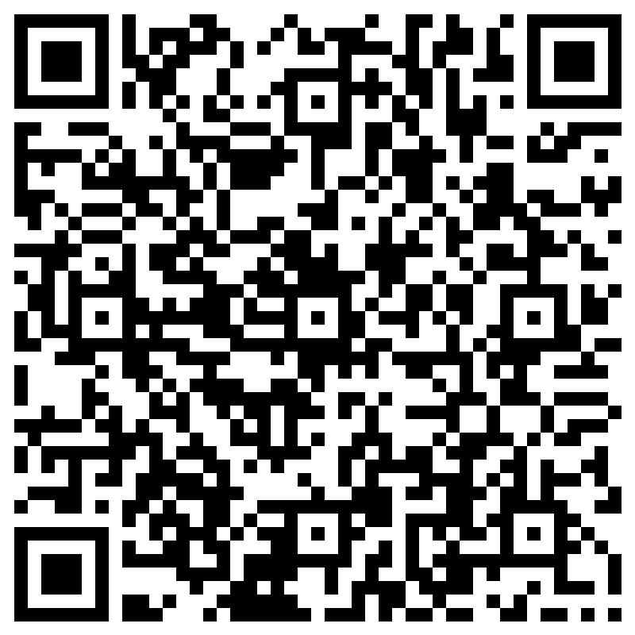
STAY CONNECTED
860-984-5333
FLLA@favor-ct.org
www.favor-ct.org
Survey

Slide 18
THANK YOU!

