Slide 1
Child & Family Homelessness & The McKinney Vento Act Michelle Anderson, MSW Anne Giordano, MA, IMH-E® EdAdvance

Slide 2
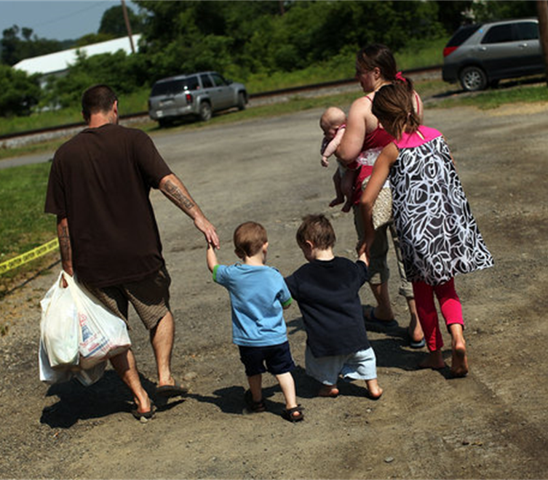
“Children experiencing homelessness are among the most invisible and neglected individuals in our nation.
Despite their ever-growing number, homeless children have no voice and no constituency.
Without a bed to call their own, they have lost safety, privacy, and the comforts of home, as well as friends, pets, possessions, reassuring routines, and community.
These losses combine to create a life-altering experience that inflicts profound and lasting scars”. –Bassuk -et.al, 2015

Slide 3
Demographics & Numbers: They Tell the Story
Infancy is the age at which a person is most likely to become homeless in the US
Approximately half of the children staying in HUD shelters are under the age of six
(SchoolHouse Connection, 2020)

Slide 4
The Face of Family Homelessness
Over 42% of homeless young women between the ages of 18-25 are pregnant or parenting.
Over 27% of families in HUD shelters are headed by someone under the age of 25.
Homeless teens are at particularly high risk for pregnancy, with as many as 20 % becoming pregnant.
(SchoolHouse Connection, 2020)

Slide 5
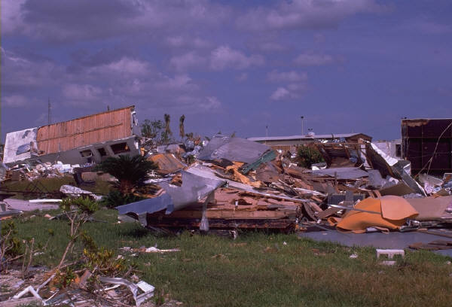
Causes of Homelessness
Lack of affordable housing, evictions & foreclosures
Poverty: economic recession & unemployment
Health problems: physical/mental health and substance use issues
Domestic violence
Abuse/neglect, family dysfunction, sexual orientation & gender identity issues, & pregnancy (unaccompanied youth)
Natural & other disasters, including fire

Slide 6
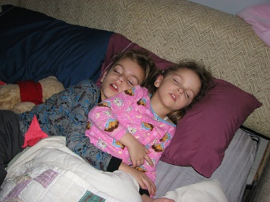
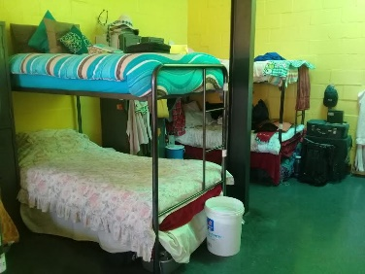
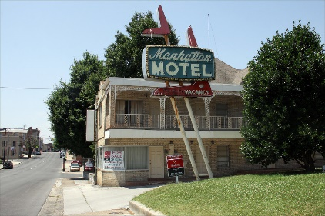
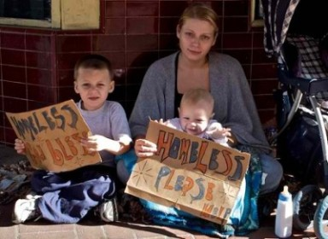
Where are Families without Permanent Homes Living?
(NAEHCY, 2014-2015)
Doubled up/sharing housing- 76 % | Shelters/transitional housing-15 %
Hotels/motels/trailers/campgrounds- 6 % | Unsheltered/on the street- 3 %
Notes:
Doubled up and/or sharing the residence of others- 76%
Shelters or transitional housing- 15%
Hotels/motels, trailer parks, campgrounds- 6%
Unsheltered or “on the streets”- 3%

Slide 7
The Experience of Homelessness in Children
Children experiencing homelessness often have-
more stress in their lives, and at early ages
anxiety over having a place to live or sleep at night
fear that something bad will happen to their families
high rates of separation from primary caregivers— as many as 12% of homeless children are placed into foster care
And- 83% have been exposed to a serious violent event by age 12
(NAEHCY, 2016)

Slide 8
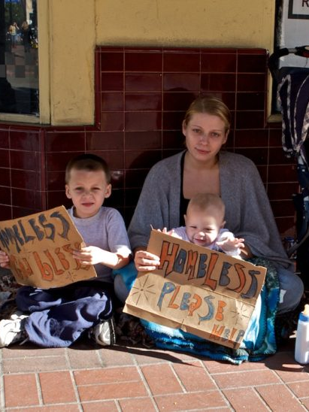
Children in Homelessness Experience:
Lower birth rates
Inadequate nutrition
Disturbances of sleep
Higher levels of childhood illnesses
Delayed development
Poor educational outcomes
Toxic stress and complex trauma
Significant behavioral and mental health issues
Child welfare involvement
(Zero to Three)

Slide 9
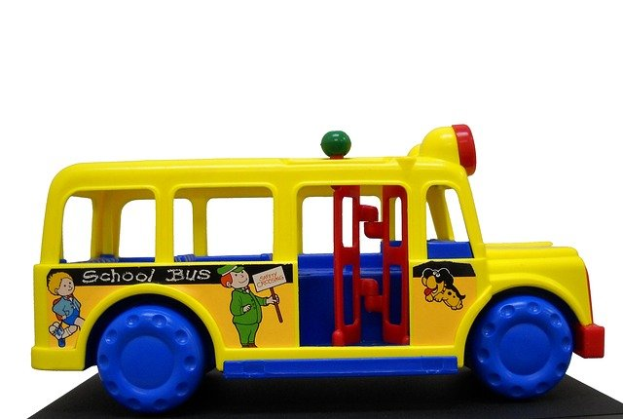
McKinney-Vento Homeless Act
Reauthorized in 2015-16 as ESSA:
Main Themes:
Identification
School Stability
School Access
Support for Academic Success
Child-centered, best interest decision making

Slide 10
State & Local McKinney Vento Liaisons
At both the state and local level, every school district in the country is required to designate a homeless liaison.
Louis Tallarita, LMSW, CT Department of Education, State McKinney Vento Coordinator
Local McKinney Vento Liaisons:
https://portal.ct.gov/-/media/SDE/Homeless/OnlineLiaisonList.xlsx

Slide 11
McKinney-Vento Act: Federal Law Protecting the Rights of Homeless Children & Families
DEFINITION- Children who lack a fixed, regular and adequate nighttime residence:
Sharing the housing of others due to loss of housing, economic hardship or similar reason
Living in motels, hotels, trailer parks, campgrounds, due to lack of other options
Living in emergency or transitional shelters
Living in a public/private place not designated for humans
Living in cars, parks, abandoned buildings, substandard housing, bus/train stations or similar settings
Migratory children
(reauthorized in 2015 : Every Student Succeeds Act)

Slide 12
Unaccompanied Youth
Definition:
Child or youth who meets the McKinney-Vento definition of homelessness and is not in the physical custody of a parent or guardian. 11434a(6)

Slide 13
Mc Kinney Vento: Provisions For School-Aged Children
Go to school, no matter where they live
Attend either local school or school of origin
Enroll in school immediately, even if key records are missing (education, health, residency)
Participate fully in all school programs while awaiting records
Receive transportation to and from school of origin
Receive free school meals
Access to the same programs and services that are available to all other students

Slide 14
School of Origin: Definition
The school attended when permanently housed or the school in which last enrolled, including a preschool. 11432(g)(3)(I)
What is a “preschool”?
Publicly-funded program for children 0-5 for which the LEA is a financial or administrative agent or is accountable for providing early childhood education.
Preschools operated, administered or funded by an LEA, including funded by Title I or similar govt. grants.
Head Start programs receiving LEA funding or for which the LEA is the grant recipient.
Preschool special education.
LEA funded or administered home-based early childhood services. Guidance N4; Fed. Data Guide

Slide 15
Mc Kinney Vento: Provisions for Very Young Children
McV Liaisons (state & local) must have plans defined that ensure family/child access to Early Head Start & Head Start, Even Start and other public preschool programs that are administered by the LEA (local education agency/district)
Homeless children are categorically eligible for Early Head Start & Head Start programs
Early care programs funded by a local education agency are required to identify and prioritize homeless children for enrollment; allow homeless to enroll while required paperwork is obtained; and coordinate with local McV liaisons
OHS information: http://eclkc.ohs.acf.hhs.gov

Slide 16
Supports & Resources for Families
Connect with local housing support providers
Connect with your local school district McKinney Vento Liaisons
Learn about local early care & education providers- especially Head Start, School Readiness, and other federally & state funded programs
ASK about younger children in the home!

Slide 18
“There is no more powerful neurobiological intervention than a nurturing relationship; it literally changes the brain.”
(Dr. Bruce Perry)
THANK YOU
for all that YOU do to Support Children & Families!

Slide 19
Closing Thoughts & Questions

