Slide 1
Head Start & Head Start on Housing for CT’s Families
Connecticut Children's Collective
February 21, 2024

Slide 2
What We Will Discuss Today
About Head Start
History
Services
Eligibility
Head Start Collaboration Offices
About Head Start on Housing (HSOH)

Slide 3
History of Head Start
1965
Project Head Start was launched as an eight-week summer demonstration project to help disadvantaged preschool children. Since then, it has served tens of millions of children.
1995
First Early Head Start (EHS) grants awarded: the vision of the 1994 reauthorization to provide services for infants, toddlers, and pregnant women.

Slide 4
Head Start Services & Delivery
Programs deliver services to children age birth to 5 and their families.
Services are provided in public schools, child care centers, family child care homes, or in the family's own home through a home visiting model.
https://eclkc.ohs.acf.hhs.gov/

Slide 5
Head Start Services
Early Care & Education: Providing a variety of learning experiences to help children grow intellectually, socially, and emotionally.
Health: Providing health services such as immunizations, dental, medical, and mental health, and nutritional services, and early identification of health problems.
Parent Engagement: Engaging parents in the planning and implementation of activities. Parents serve on policy councils and committees that make administrative decisions; participate in classes and workshops on child development; and are offered volunteer opportunities.
Social Services: Provide outreach to families to help identify their strengths and determine what services they may need or desire.

Slide 6
Head Start Eligibility
The Family Income is at or below the Federal Poverty Guidelines
Child is a Foster Child
Child/Family Receives Public Assistance: Temporary Assistance for Needy Families (TANF), Supplemental Security Income (SSI), or Supplemental Nutrition Assistance Program (SNAP)
Child/Family is experiencing homelessness
https://aspe.hhs.gov/topics/poverty-economic-mobility/poverty-guidelines

Slide 7
Head Start Collaboration Offices
HSCOs exist “to facilitate collaboration among Head Start agencies and entities that carry out activities designed to benefit low-income children from birth to school entry, and their families," according to the Head Start Act, Section 642(B)(a)(2)(A).
Communication: Convene stakeholder groups for information sharing, planning, and partnering and serve as a conduit of information between regional offices, the state and local early childhood systems.
Access: Facilitate Head Start agencies’ access to, and utilization of, appropriate entities so Head Start children and families can secure needed services and critical partnerships are formalized.
Systems: Support policy, planning, partnerships, and implementation of cross-agency state systems for early childhood, including the Early Childhood Cabinet, that include and serve the Head Start community.

Slide 8
Head Start on Housing

Slide 9
Connecticut Children & Families Experiencing Homelessness
Program Information Report (PIR) Data: Children | 2023 | % of Children 2023
Total number of children experiencing homelessness that were served during the enrollment year | 441 | 7.7
Program Information Report (PIR) Data: Families | 2023
Total number of families experiencing homelessness that were served during the enrollment year | 420
Total number of families experiencing homelessness that acquired housing during the enrollment year | 119
Total number of families experiencing homelessness that did not acquire housing during the enrollment year | 301
The Big Picture – In school year 2020-2021, 1,028,560 children ages 0-6 experienced homelessness but only 44,228 were identified and enrolled in Head Start/Early Head Start.

Slide 10
Overview of Head Start on Housing Program
Since January 2022, the Connecticut Department of Housing (DOH) has allocated housing vouchers for families whose children are participating in Connecticut’s Head Start (HS) and Early Head Start (EHS) programs.
In January 2022, the Connecticut Office of Early Childhood (OEC) received 25 housing vouchers from DOH for EHS/HS families.
In June 2022, Connecticut Governor Ned Lamont, DOH and OEC announced an additional 35 Housing Choice vouchers for this program.
In September 2022, CT Department of Housing changed its administrative plan to allocate approximately fifty (50) Housing Choice vouchers annually for Head Start and Early Head Start families.

Slide 11
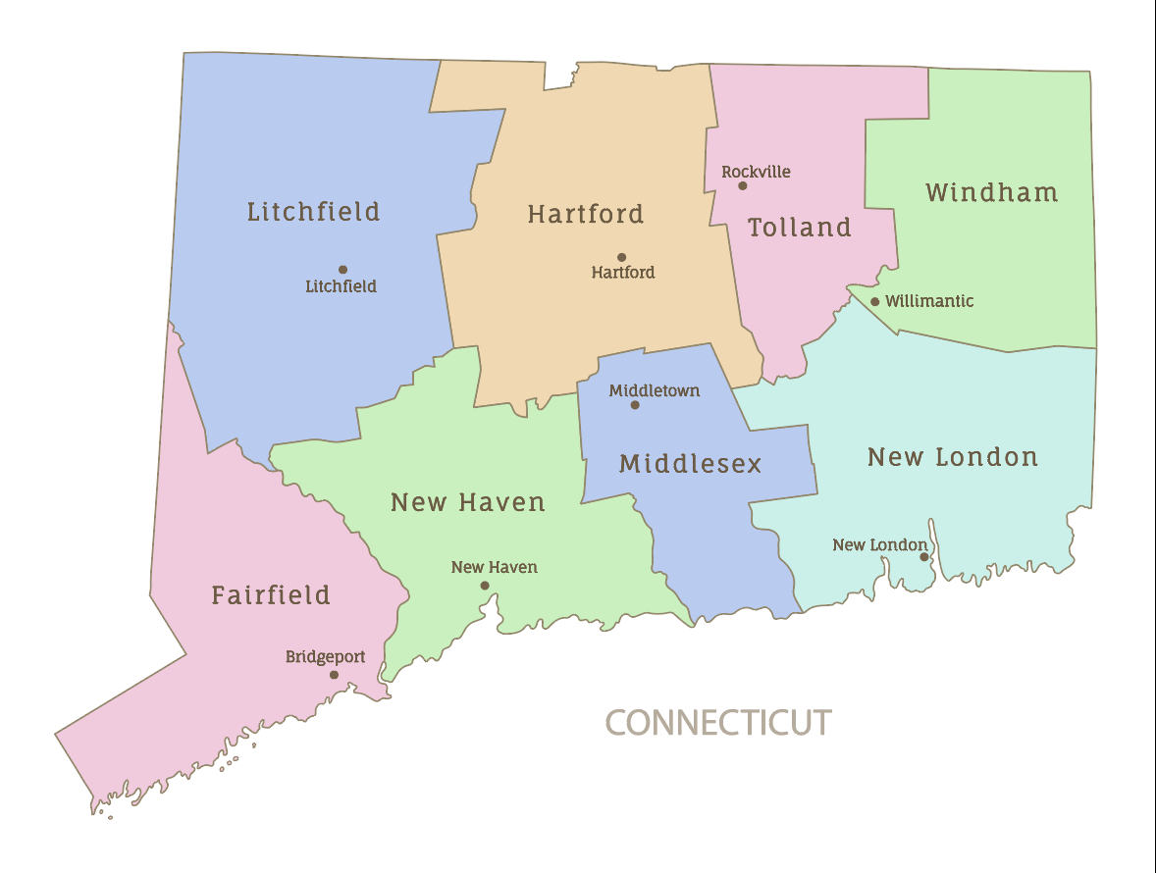
Our Head Start/Early Head Start Partners
Alliance for Community Empowerment, Inc.
Area Cooperative Educational Services (ACES)
Capitol Region Education Council (CREC)
Children's Learning Centers, Inc. (CLC)
City of New Haven, Inc.
EASTCONN Head Start
EdAdvance
Enfield Head Start
Human Resources Agency of New Britain, Inc. (HRA)
LULAC Head Start, Inc
Manchester Memorial Hospital (ECHN)
Thames Valley Council for Community Action, Inc. (TVCCA)
The West Haven Community House Association, Inc.
Training Education & Manpower, Inc. (TEAM)
United Way of Greater New Haven
Manchester Head Start
East Hartford Head Start
Meriden YMCA Head Start
8
3
17
7
11
6
16
9
14
2
18
12
10
13
15
5
4
1

Slide 12
The Partners
Head Start/Early Head Start programs
Connecticut Department of Housing
Connecticut Office of Early Childhood
Connecticut Head Start State Collaboration Office
Connecticut State Department of Education
Connecticut Head Start Association
National Center for Housing and Child Welfare

Slide 13
The Impact
Children Housed | Families Housed
151 104 Early Head Start/Head Start 47 School-Age | 67

Slide 14
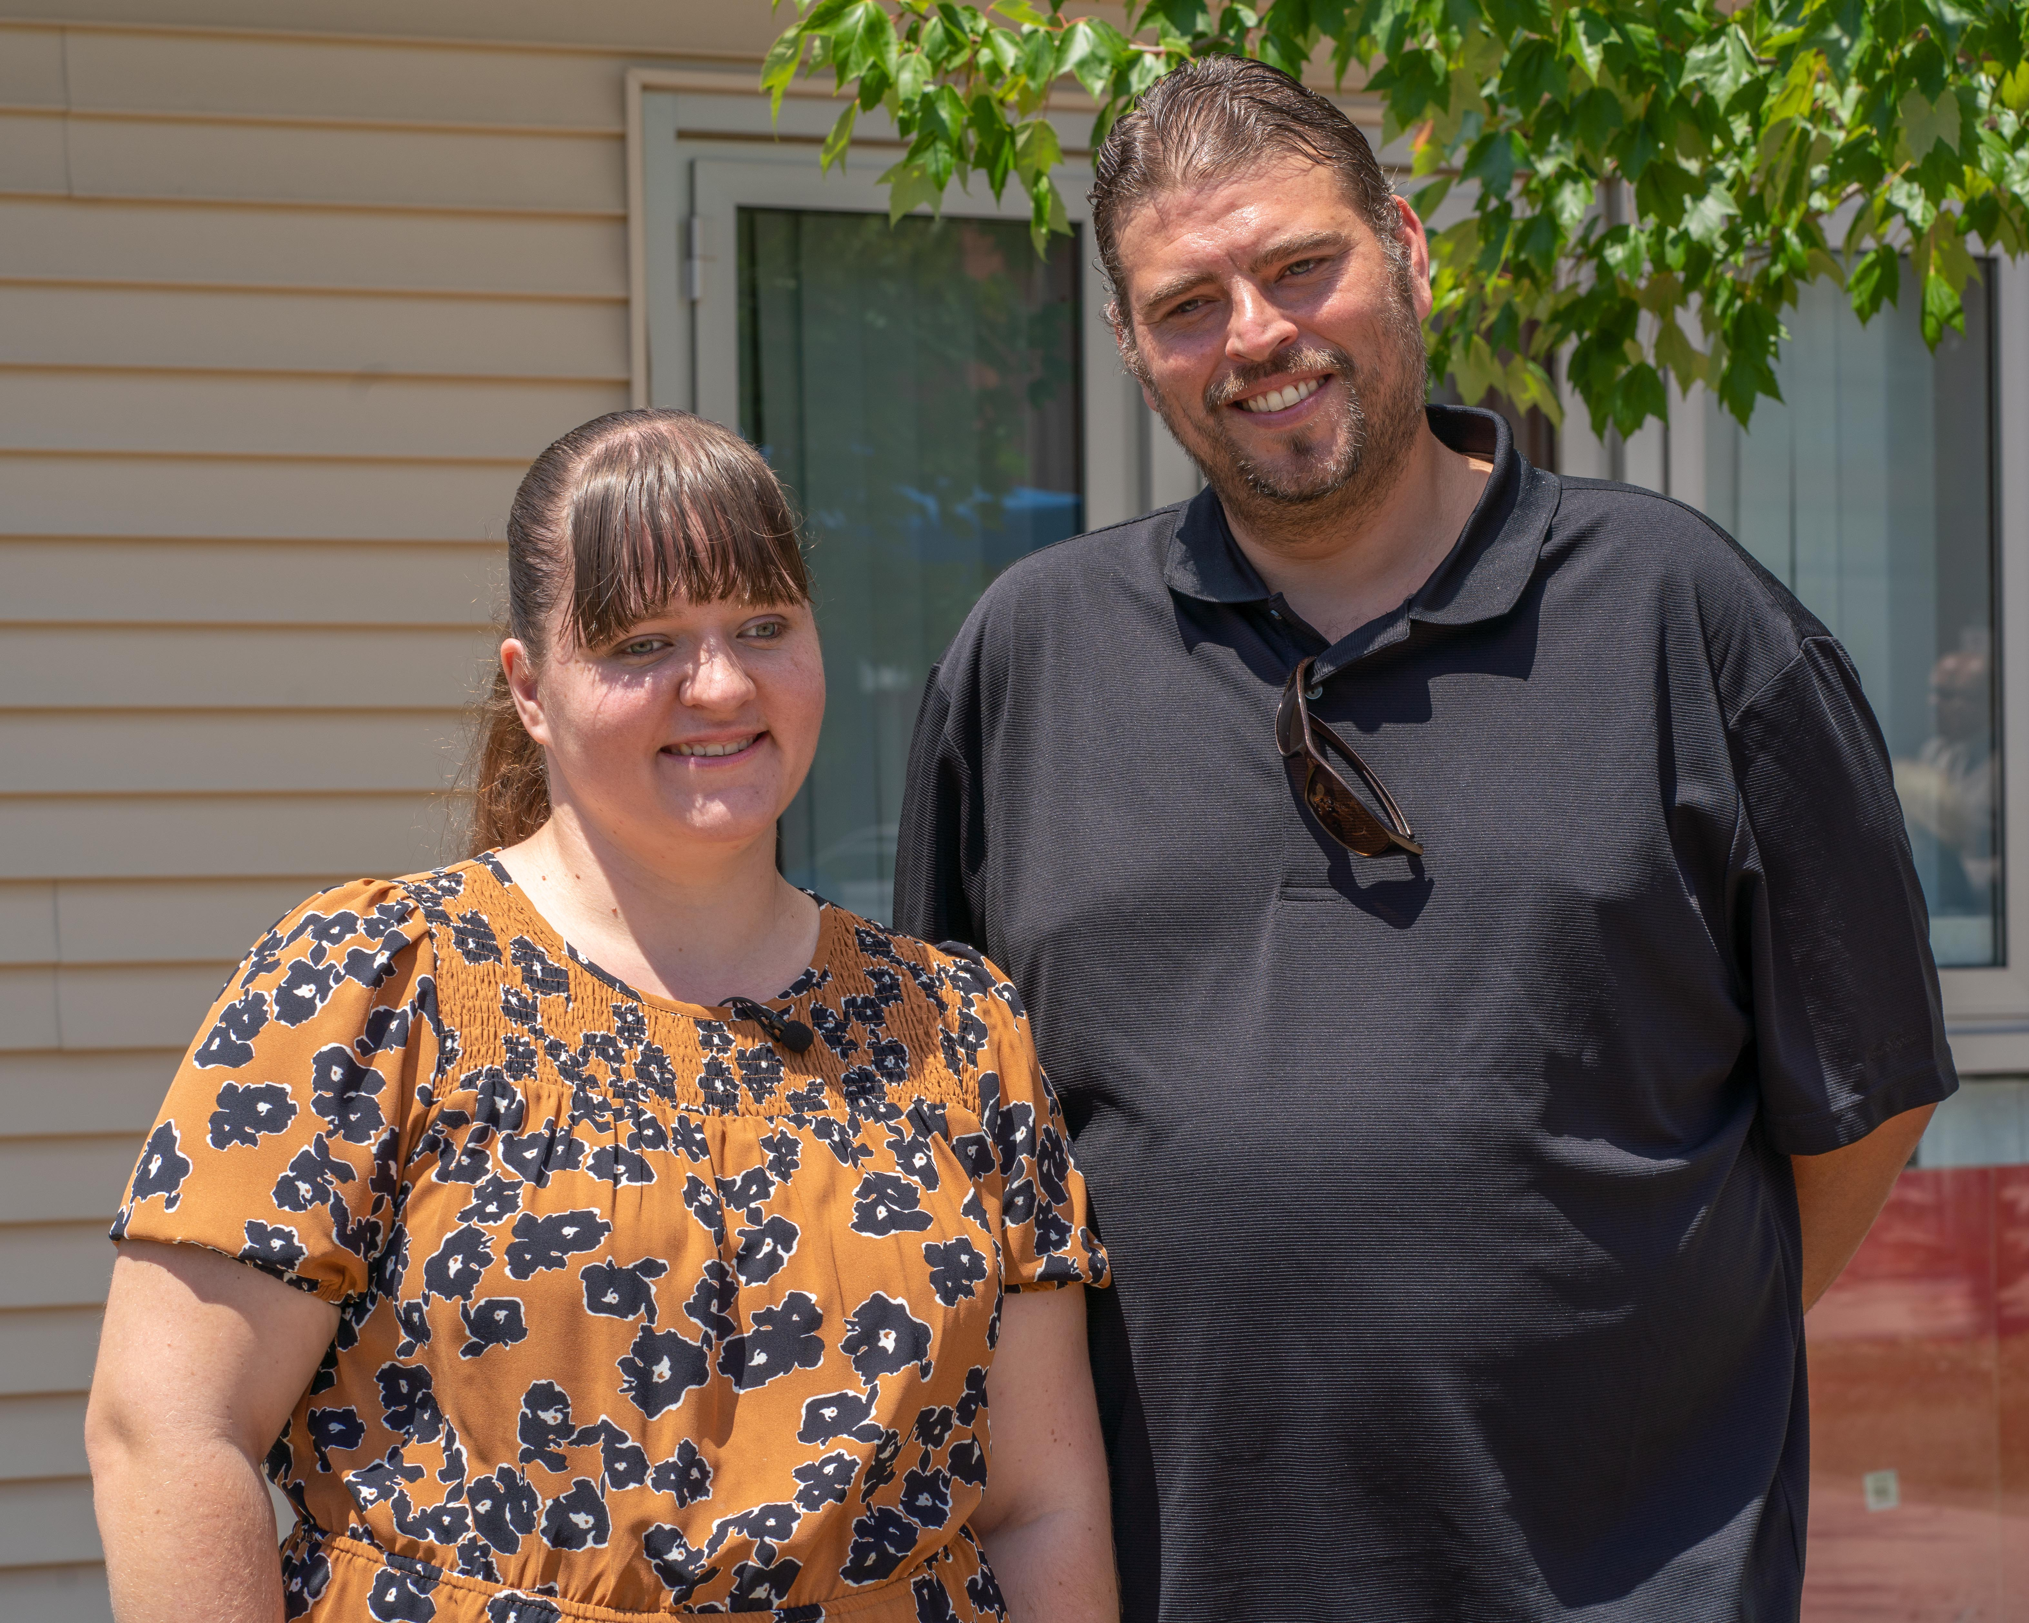
Families & Partners Behind the Vouchers
Dr. Monette Ferguson, Executive Director
Alliance for Community Empowerment
Steve DiLella, CT Department of Housing
Erica & her son
Early Head Start family housed through program

Slide 15
Statewide Landlord Recruitment Campaign

Slide 16
To Learn More
Head Start | Dept. of Housing
Connecticut Head Start State Collaboration Office Karen Pascale, Director Head Start State Collaboration Office Office of Early Childhood 450 Columbus Boulevard Hartford, CT 06103 Karen.Pascale@ct.gov | Connecticut Department of Housing Dr. Shante' Hanks, Senior Advisor for Education & Housing Stability Department of Housing 505 Hudson Street, Hartford, CT 06106 Shante.Hanks@ct.gov
headstartonhousingct.com

